Slide 1
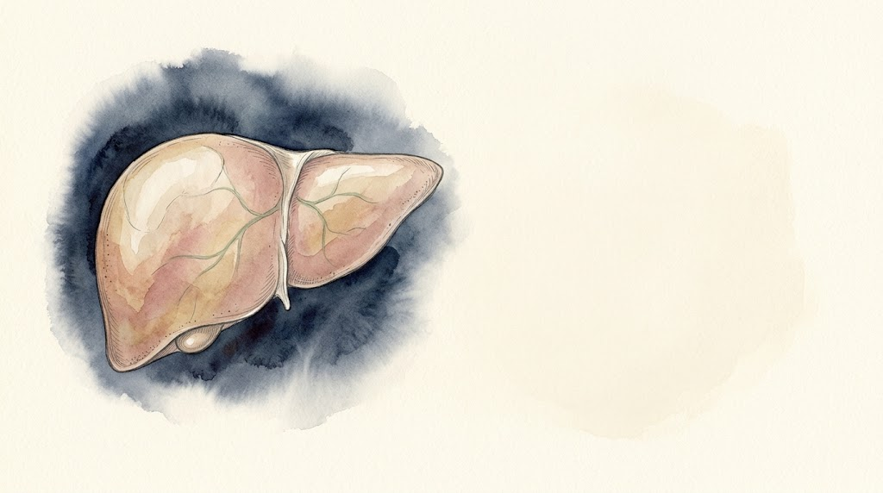


Acute Liver Failure
and ACLF in the ICU
Mohammad Almeqdadi, MD
Transplant Hepatologist and Gastroenterologist
Assistant Professor of Medicine and Surgery
X: @mfalmeqdadi
Slides (PDF)
Illustrations generated with Google Gemini
Notes:
Pulmonary and critical care fellows. About 60 minutes with questions as we go. Two patients in the unit at the same time. Everything in the cases is made up for teaching; none of it is a real patient.

Slide 2
Objectives
By the end of this talk you should be able to:
Tell acute liver failure apart from severe acute liver injury and from ACLF
Start the first-hour care of ALF: cause, NAC, glucose, airway
Protect the brain in ALF and know when to intubate
Start CRRT for ammonia without waiting for a renal indication
Diagnose and grade ACLF, and find the trigger
Work through AKI in cirrhosis, including HRS-AKI, without hurting the lungs
Know when to call transplant hepatology
Notes:
We'll get to each of these through two patients who are in the unit at the same time.

Slide 3
Two patients, same ICU
Bed 4 | Bed 7
28-year-old woman | 56-year-old man
No known liver disease | Alcohol-related cirrhosis with ascites
Nausea and vomiting for 4 days | Fever, confusion, low blood pressure
Both have a sick liver. Do they have the same disease?
Notes:
Introduce both up front so the contrast is there from the start. We'll start with bed 4 and come back to bed 7.

Slide 4

Bed 4
28F, acute liver failure
Notes:
First patient.

Slide 5
28F, 4 days of nausea
Nausea, vomiting and poor intake for 4 days
No known liver disease, no alcohol use
"Took something for a toothache"
Test | Result
AST | 6,820 U/L
ALT | 5,940 U/L
Alkaline phosphatase | 128 U/L
Total bilirubin | 2.9 mg/dL
Creatinine | 1.0 mg/dL
Is this acute liver failure?
Notes:
Let them commit. Most people will say yes because the numbers are huge. The aminotransferases tell you hepatocytes are dying. They don't tell you whether the liver is failing.

Slide 6
28F, 4 days of nausea
Nausea, vomiting and poor intake for 4 days
No known liver disease, no alcohol use
"Took something for a toothache"
Test | Result
AST | 6,820 U/L
ALT | 5,940 U/L
Alkaline phosphatase | 128 U/L
Total bilirubin | 2.9 mg/dL
Creatinine | 1.0 mg/dL
Is this acute liver failure?
We don't know yet. What's missing?
Notes:
This is the same distinction as in the acute liver injury lecture: the size of the enzyme rise is not the severity of the illness.

Slide 7
28F, 4 days of nausea
Nausea, vomiting and poor intake for 4 days
No known liver disease, no alcohol use
"Took something for a toothache"
Test | Result
AST | 6,820 U/L
ALT | 5,940 U/L
Alkaline phosphatase | 128 U/L
Total bilirubin | 2.9 mg/dL
Creatinine | 1.0 mg/dL
What's missing?
INR (synthetic function, not enzymes)
Mental status (any encephalopathy?)
Time course (how long since the first symptom?)
Is there chronic liver disease underneath?
Notes:
Liver failure is a clinical diagnosis: coagulopathy plus encephalopathy in someone without cirrhosis. Ask for the INR and examine the patient.

Slide 8
28F, 4 days of nausea
Disoriented to time, asterixis. Still there after the glucose is fixed
Symptoms started 4 days ago
Ultrasound: smooth liver, no ascites, patent vessels, normal spleen
No history or imaging suggesting cirrhosis
Test | Result
AST | 6,820 U/L
ALT | 5,940 U/L
Total bilirubin | 2.9 mg/dL
INR | 3.2
Glucose | 54 mg/dL
Now is it acute liver failure?
Notes:
Coagulopathy, encephalopathy, short course, no cirrhosis. Note the glucose: hypoglycemia is part of the picture, and it is also a reason the mental status can look worse than it is. Fix the glucose and re-examine.

Slide 9
28F, 4 days of nausea
Disoriented to time, asterixis. Still there after the glucose is fixed
Symptoms started 4 days ago
Ultrasound: smooth liver, no ascites, patent vessels, normal spleen
No history or imaging suggesting cirrhosis
Test | Result
AST | 6,820 U/L
ALT | 5,940 U/L
Total bilirubin | 2.9 mg/dL
INR | 3.2
Glucose | 54 mg/dL
This is acute liver failure
Notes:
Coagulopathy, encephalopathy, short course, no cirrhosis. Note the glucose: hypoglycemia is part of the picture, and it is also a reason the mental status can look worse than it is. Fix the glucose and re-examine.

Slide 10
Acute liver failure
INR ≥ 1.5 and any degree of encephalopathy
Illness of less than 26 weeks
No pre-existing cirrhosis
  AASLD and ACG: chronic liver disease without cirrhosis still allows ALF. EASL: no prior liver disease at all
  Wilson disease, autoimmune hepatitis and vertically acquired HBV can still count if recognized within 26 weeks
Jaundice to encephalopathy | Hyperacute (< 1 week) | Acute (1 to 4 weeks) | Subacute (4 to 12 weeks)
Typical causes | Acetaminophen, HAV, HEV, ischemia | HBV | Idiosyncratic drug injury, AIH, indeterminate
Cerebral edema | Common | Less common | Uncommon
Recovery without transplant | More likely | Intermediate | Less likely
EASL ALF guideline 2017 [PMID: 28417882]; ACG ALF 2023 [PMID: 37377263]; Management of ALF: update 2022 [PMID: 36001996]
Notes:
The time course is not trivia. The faster it comes on, the more you worry about the brain, and paradoxically the better the chance of spontaneous recovery. The slow ones have less cerebral edema but do worse without a transplant. Patient A is hyperacute.

Slide 11
INR 2.4, wide awake. Acute liver failure?
What do you call this, and what do you do now?

Slide 12
INR 2.4, wide awake. Acute liver failure?
No. This is severe acute liver injury
No encephalopathy means not yet ALF
But it can become ALF within hours
  Check glucose often and examine the patient every few hours
  Call transplant hepatology early anyway
And the opposite trap:
  Hypoglycemia, sedatives, sepsis, alcohol withdrawal and seizures can all look like encephalopathy
Notes:
Two errors in opposite directions. Calling everything with a high INR liver failure, and blaming every change in mental status on the liver.

Slide 13
What else fails?
It's called liver failure. Which other organs fail?
Notes:
Let them list organs. Most will get brain and kidney. Fewer think of the adrenals, the marrow or the immune system.

Slide 14
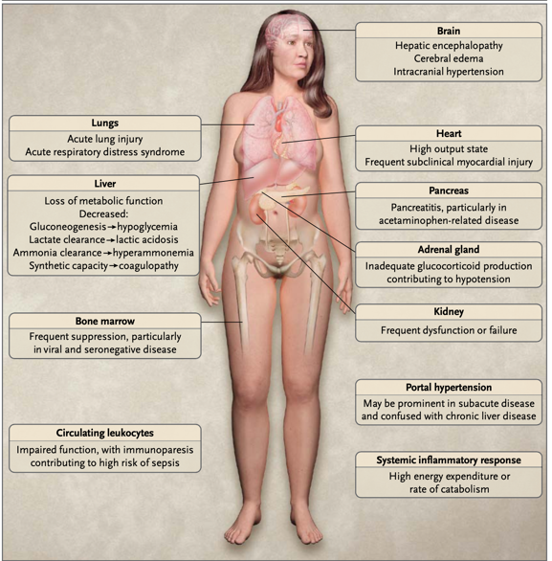
What else fails?
Bernal W, Wendon J. N Engl J Med 2013;369:2525-34, Figure 1
Notes:
This is why these patients are ICU patients. Hypoglycemia, lactic acidosis, vasodilatory shock, relative adrenal insufficiency, AKI, lung injury and a high risk of infection. The liver is one organ on this picture.

Slide 15
28F, 4 days of nausea
What's your next step?
Notes:
Wait for answers. Usually people list tests in order. That's the trap.

Slide 16
Three things, at the same time
Keep her alive | Find and treat the cause | Call transplant hepatology
ICU bed Glucose every 1 to 2 hours Airway assessment Volume, perfusion, lactate Neuro checks | Acetaminophen level Viral, autoimmune, Wilson, toxicology Doppler ultrasound Pregnancy test Start NAC if acetaminophen is possible | Now, not after the workup Transplant evaluation starts on admission Social work and psychiatry while she can still talk
All three start in the first hour
Notes:
The classic mistake is a serial workup: wait for the hepatitis panel, then the autoimmune markers, then call hepatology. By then she is intubated and the evaluation has lost a day. Here the transplant evaluation runs in parallel from admission, and the psychosocial part is much easier while she can still talk.

Slide 17
Which cause changes treatment right away?
If you suspect | Send | Don't wait for the result to
Acetaminophen | Level, ingestion history, combination products
Herpes simplex | HSV PCR (blood)
Hepatitis B | HBsAg, anti-HBc IgM, HBV DNA
Autoimmune hepatitis | ANA, ASMA, IgG (can be negative)
Wilson disease | Ceruloplasmin, urine copper, hemolysis, low ALP
Pregnancy (AFLP, HELLP) | hCG
Budd-Chiari | Doppler ultrasound or CT
Ischemic hepatitis | Echo, history of shock
Mushrooms (Amanita) | Wild mushrooms, then diarrhea 6 to 24 hours later
Update 2022 [PMID: 36001996]; practical update 2024 [PMID: 39170946]; EASL AIH 2025 [PMID: 40348684]
Notes:
The point of the workup in the ICU is the column on the right. Some of these you start empirically before the test comes back: NAC, acyclovir. Negative autoimmune serologies do not exclude acute AIH. Wilson disease presenting as ALF basically means transplant.

Slide 18
Which cause changes treatment right away?
If you suspect | Send | Don't wait for the result to
Acetaminophen | Level, ingestion history, combination products | Start NAC
Herpes simplex | HSV PCR (blood) | Start IV acyclovir
Hepatitis B | HBsAg, anti-HBc IgM, HBV DNA | Start entecavir or tenofovir
Autoimmune hepatitis | ANA, ASMA, IgG (can be negative) | Discuss steroids with hepatology, list in parallel
Wilson disease | Ceruloplasmin, urine copper, hemolysis, low ALP | Prepare for urgent transplant
Pregnancy (AFLP, HELLP) | hCG | Call obstetrics, plan delivery
Budd-Chiari | Doppler ultrasound or CT | Anticoagulation, discuss TIPS or transplant
Ischemic hepatitis | Echo, history of shock | Fix the circulation
Mushrooms (Amanita) | Wild mushrooms, then diarrhea 6 to 24 hours later | NAC, call poison control (silibinin if available)
Update 2022 [PMID: 36001996]; practical update 2024 [PMID: 39170946]; EASL AIH 2025 [PMID: 40348684]
Notes:
The point of the workup in the ICU is the column on the right. Some of these you start empirically before the test comes back: NAC, acyclovir. Negative autoimmune serologies do not exclude acute AIH. Wilson disease presenting as ALF basically means transplant.

Slide 19
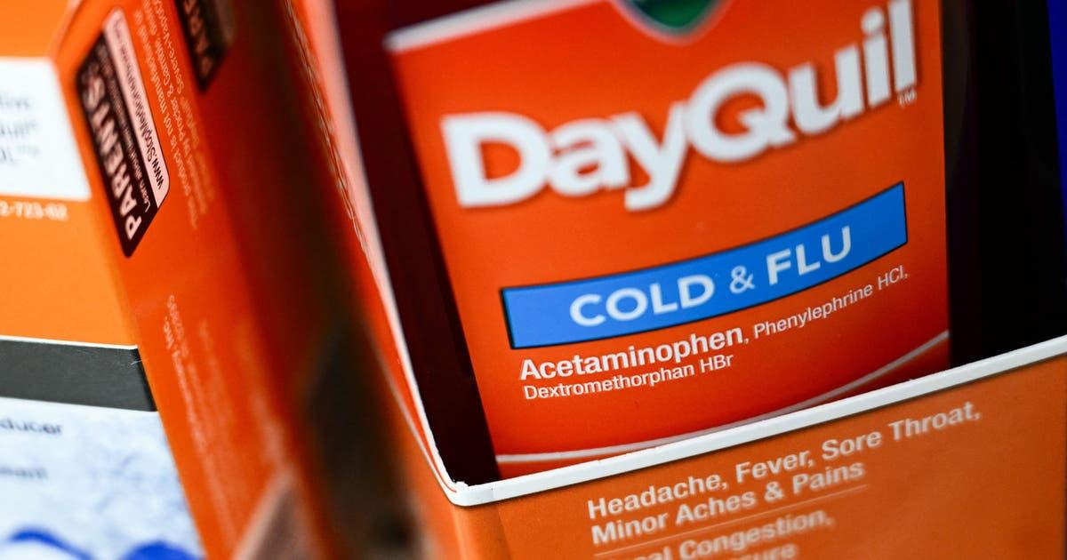
28F, 4 days of nausea
Roommate: "She was taking a lot of the Tylenol with codeine, plus cold medicine, for 3 days"
Acetaminophen level: 12 μg/mL, time of last dose unknown
Can you use the nomogram?
Notes:
Combination products are where the hidden acetaminophen is. Ask about every over-the-counter product by name.

Slide 20
The Rumack-Matthew nomogram
One acute ingestion at a known time: it tells you when NOT to give NAC
Late, repeated or unknown-time ingestion: a low level doesn't rule out liver injury
If she had taken it all at once
8 hours: 12 is below the line, no NAC
20 hours: above the line, NAC
But it was 3 days of repeated doses. There is no time zero. Give NAC
Rumack BH, Matthew H. Pediatrics 1975; US/Canada acetaminophen consensus 2023 [PMID: 37552484]
Notes:
Show them what it is first: a semi-log plot, the line halves every 4 hours (a half-life of about 4 hours), and the US treatment line sits 25% below the original 200 line for a safety margin. Then try to put her on it. Her 12 crosses the treatment line at roughly 18 to 19 hours. Before that she looks fine, after that she needs NAC. The point to leave them with: the nomogram is a tool for deciding who can safely go without NAC after a single timed ingestion. It is not the trigger for starting NAC in someone who is already sick. Call poison control or toxicology early. Opioids, including the codeine in her Tylenol with codeine, can slow absorption, so a single early level can mislead after an acute ingestion. With repeated supratherapeutic dosing over 3 days there is no single ingestion time, so it can't clear her, and she gets NAC.

Slide 21
28F, 4 days of nausea
Roommate: "She was taking a lot of the Tylenol with codeine, plus cold medicine, for 3 days"
Acetaminophen level: 12 μg/mL, time of last dose unknown
Can you use the nomogram?
No. Rumack-Matthew is for a single acute ingestion with a known time
Repeated supratherapeutic use and late presentation: the level can be low or undetectable
Start NAC now
Notes:
An undetectable or low level late in the course does not exclude acetaminophen toxicity [PMID: 36001996]. NAC is safe enough that the threshold to start it is low. Dosing per your pharmacy protocol.

Slide 22
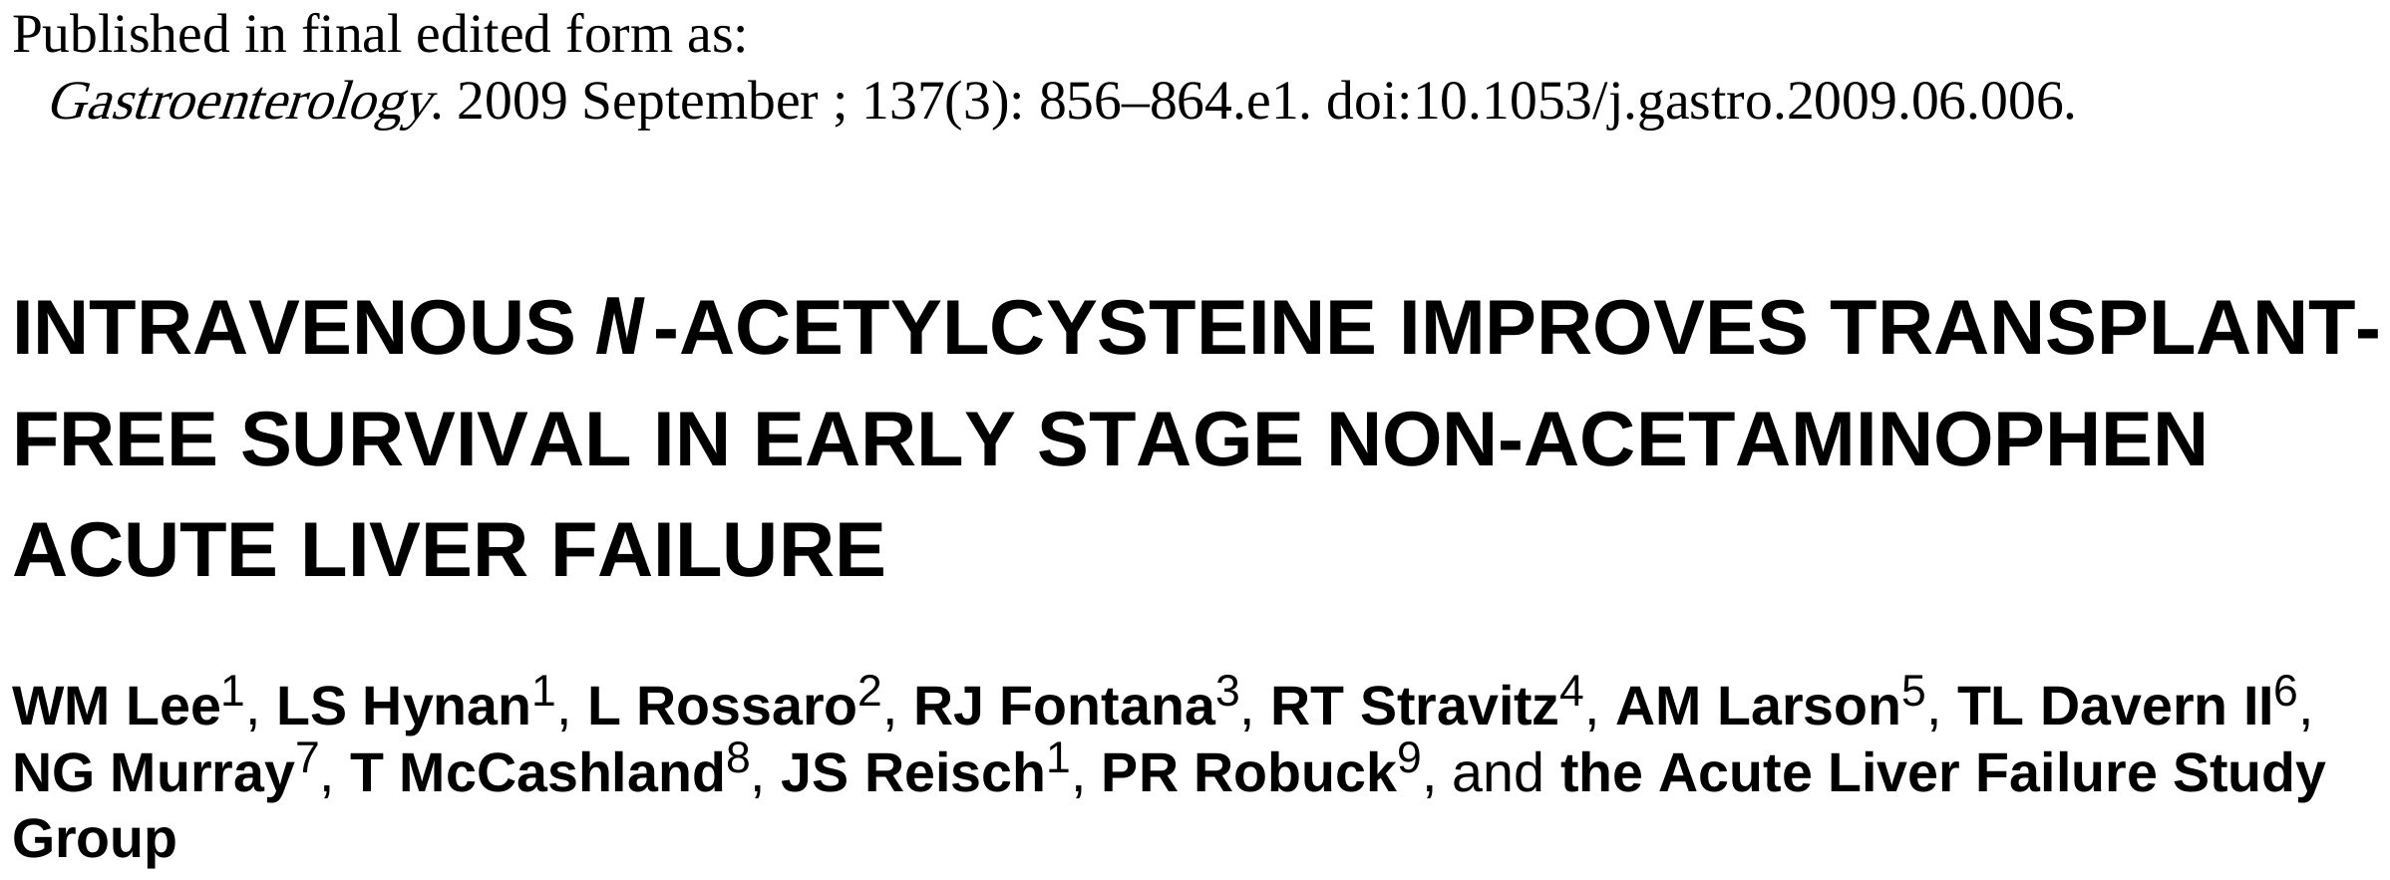
NAC for every kind of acute liver failure?
What do you think they found?
Lee WM et al. Gastroenterology 2009;137:856-64 [PMID: 19524577]

Slide 23
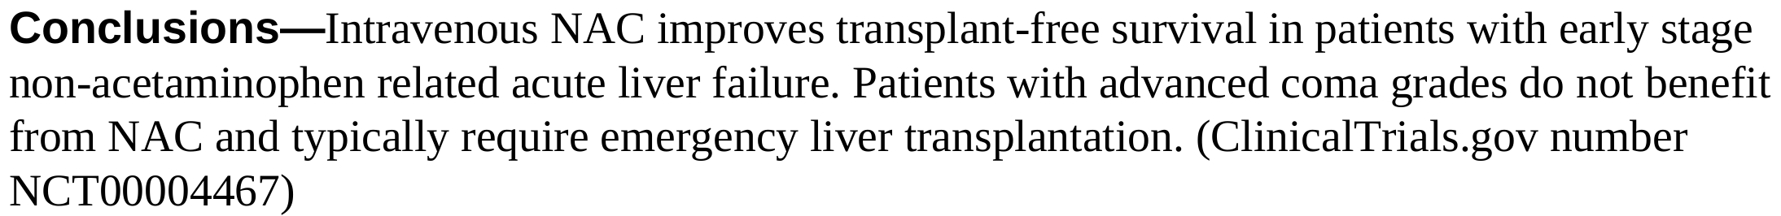
NAC for every kind of acute liver failure?
Lee WM et al. Gastroenterology 2009;137:856-64 [PMID: 19524577]
Notes:
The ALFSG trial: 173 adults with non-acetaminophen ALF, NAC or placebo for 72 hours, 24 US centers. Read their conclusion, then the numbers.

Slide 24
NAC for every kind of acute liver failure?
Adult non-acetaminophen ALF, randomized, NAC vs placebo, 173 patients
Reasonable in early non-acetaminophen ALF. Don't extrapolate to advanced coma, children or ACLF
Lee WM et al. Gastroenterology 2009 [PMID: 19524577]
Notes:
Overall survival at 3 weeks was not different. The transplant-free survival benefit was in coma grade I-II, which is a subgroup. That doesn't support NAC in advanced non-acetaminophen ALF or in ACLF. ACG 2023 suggests NAC in non-acetaminophen ALF; this trial is why the early-coma patients are the ones most likely to benefit. And don't carry the grade III-IV result over to Patient A: in acetaminophen ALF, NAC continues when she gets worse.

Slide 25
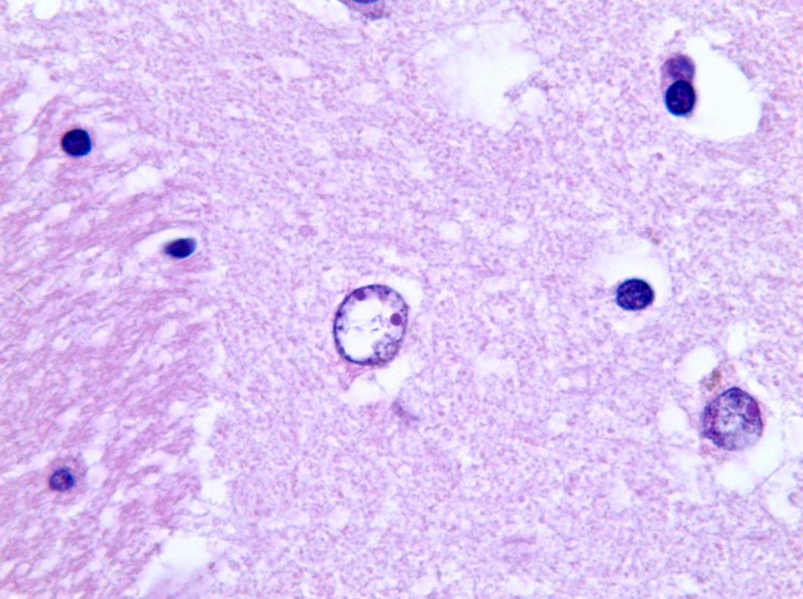
Her brain
Hour 12
Alzheimer type II astrocytes: the brain adapting over months of cirrhosis. In ALF there are no months
Notes:
Astrocytes in chronic liver disease have time to adapt to ammonia. In hyperacute ALF they don't, and they swell.

Slide 26
28F, 4 days of nausea
 | Admission | Hour 12
Mental status | Disoriented, asterixis | Responds only to voice (grade III)
Ammonia (arterial) | Not sent | 182 μmol/L
Urine output | OK | 15 mL/h for 4 hours
Lactate (after 3 L) | 2.1 mmol/L | 4.6 mmol/L
Creatinine | 1.0 mg/dL | 1.3 mg/dL
Sodium | 136 mmol/L | 133 mmol/L
Glucose | 54 mg/dL | Needs D10
What worries you most?
Notes:
Hour 12. Hepatology has seen her and the transplant evaluation is under way. Let them pick. Kidney? Lactate? The answer for a hyperacute patient with this ammonia is the brain.

Slide 27
28F, 4 days of nausea
 | Admission | Hour 12
Mental status | Disoriented, asterixis | Responds only to voice (grade III)
Ammonia (arterial) | Not sent | 182 μmol/L
Urine output | OK | 15 mL/h for 4 hours
Lactate (after 3 L) | 2.1 mmol/L | 4.6 mmol/L
Creatinine | 1.0 mg/dL | 1.3 mg/dL
Sodium | 136 mmol/L | 133 mmol/L
Glucose | 54 mg/dL | Needs D10
Her brain
When do you intubate? Do you wait for the creatinine before dialysis?
Notes:
Two decisions we own as intensivists. Before answering, why is the brain the problem?

Slide 28
Why does the brain swell?
Liver can't clear ammonia
Astrocytes take up ammonia
Ammonia + glutamate → glutamine
Intracranial hypertension, herniation
Astrocyte swelling, cerebral edema
Glutamine pulls in water, mitochondria fail
Makes it worse: inflammation and infection, loss of autoregulation, fever, low sodium, high CO2
Highest risk: hyperacute course, young, grade III-IV encephalopathy, ammonia persistently above 150 to 200 μmol/L, AKI, vasopressors
Update 2022 [PMID: 36001996]; practical update 2024 [PMID: 39170946]
Notes:
This is why ammonia is actionable in ALF. The brain has no time to adapt, unlike in cirrhosis where astrocytes compensate over months. Every element of the bundle that follows maps to a box on this slide.

Slide 29
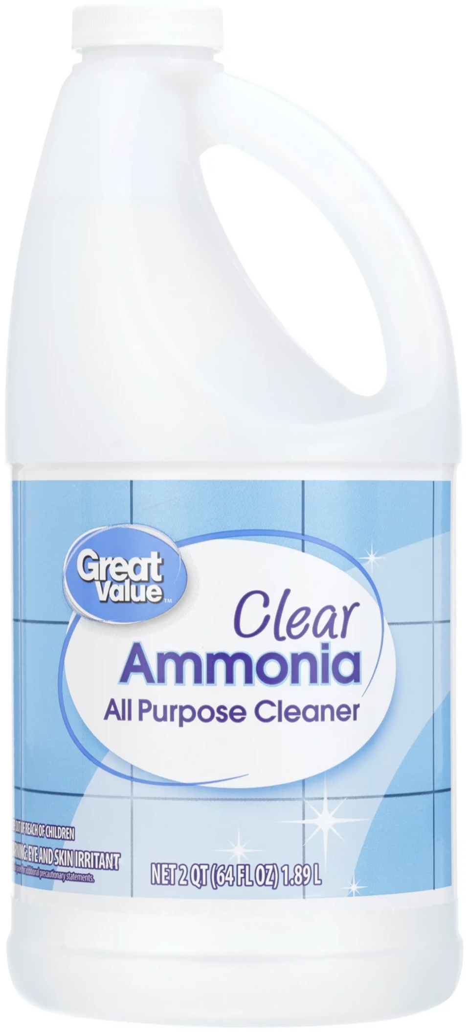
Ammonia: how high is too high?
146
So what number worries you?
Clemmesen JO et al. Hepatology 1999 [PMID: 10051463]; Kumar R et al. Clin Gastroenterol Hepatol 2012 [PMID: 22521861]; more studies in the appendix
Notes:
Left: in Copenhagen, ammonia was drawn at the onset of grade III encephalopathy. The 14 patients who herniated had about twice the arterial ammonia of those who didn't, and all of them were above 146. Right: in Delhi, ammonia that stayed at or above 122 for three days went with a third of the survival and twice the cerebral edema of ammonia that came down. These are associations, not proof that lowering the number saves the patient, but they are why we trend it and start CRRT. In Bernal's King's cohort, more than 200 meant intracranial hypertension in 55%, yet most patients who developed ICH were below 200. Practical point: whatever you send, put it on ice and get it run quickly. A delayed sample reads falsely high. In cirrhosis, a single ammonia doesn't diagnose HE and shouldn't be trended to dose lactulose.

Slide 30
Ammonia: how high is too high?
146
Above 150 to 200 and not falling: worry about the brain
No single level rules ICH in or out. Read it with the HE grade and the trend
Clemmesen JO et al. Hepatology 1999 [PMID: 10051463]; Kumar R et al. Clin Gastroenterol Hepatol 2012 [PMID: 22521861]; more studies in the appendix
Notes:
Left: in Copenhagen, ammonia was drawn at the onset of grade III encephalopathy. The 14 patients who herniated had about twice the arterial ammonia of those who didn't, and all of them were above 146. Right: in Delhi, ammonia that stayed at or above 122 for three days went with a third of the survival and twice the cerebral edema of ammonia that came down. These are associations, not proof that lowering the number saves the patient, but they are why we trend it and start CRRT. In Bernal's King's cohort, more than 200 meant intracranial hypertension in 55%, yet most patients who developed ICH were below 200. Practical point: whatever you send, put it on ice and get it run quickly. A delayed sample reads falsely high. In cirrhosis, a single ammonia doesn't diagnose HE and shouldn't be trended to dose lactulose.

Slide 31
Lactulose for her?
Hour 12: ammonia 182 μmol/L, grade III. In a cirrhotic we'd already be giving it
Yes or no?

Slide 32
Lactulose for her?
Hour 12: ammonia 182 μmol/L, grade III. In a cirrhotic we'd already be giving it
Why people give it | Why not
Ammonia drives the brain swelling | No proven benefit. ALFSG matched comparison: a little longer survival time, no difference in encephalopathy or outcome
It's what we do in cirrhosis | Gas-distended bowel gets in the surgeon's way at transplant
Cheap, and the AASLD position paper allows it in early grades, short of diarrhea | Diarrhea means free water loss and volume swings, which fight your sodium target
 | Liquid by mouth or tube in a patient who can't protect her airway: aspiration
Not for her: CRRT for the ammonia, protect the airway, keep the sodium up
AASLD position paper 2011, rec. 26; Alba L, Hay JE, Lee WM et al. J Hepatol 2002;36(Suppl 1):33 (abstract); ACG ALF 2023 [PMID: 37377263]
Notes:
The ALF Study Group data were a retrospective comparison presented only as an abstract: a small increase in survival time with lactulose, no difference in encephalopathy grade or overall outcome. The 2011 AASLD position paper allowed lactulose in early encephalopathy, orally or rectally, but not to the point of diarrhea, and warned about bowel distension during transplant. Neither the 2023 ACG guideline nor EASL 2017 recommends it. Once she is grade III-IV the tools that lower ammonia are CRRT and time. In ACLF it's the opposite: lactulose is first-line for overt HE.

Slide 33
When do you intubate?
Responds to voice, drifts off, intermittently agitated
Handling secretions for now
SpO2 96% on 2 L
Intubate now, or wait until she can't protect her airway?
Notes:
I'd intubate her now. Most fellows want to wait. In ALF the progression from grade II to grade IV can be fast, and an emergency intubation in a coagulopathic, hypotensive patient with a swollen brain is the worst version of this procedure.

Slide 34
When do you intubate?
Grade III-IV encephalopathy in ALF: intubate
Before | During | After
Preoxygenate Norepinephrine ready Check glucose Head of bed 30°, neck neutral | Avoid hypotension (perfusion pressure) Avoid coughing and bucking (ICP spikes) Most experienced operator | Propofol: short-acting, may lower ICP Avoid long-acting benzodiazepines Aim for normal CO2, check a gas Sedation hides the neuro exam: check pupils
Practical update 2024 [PMID: 39170946]; ACG ALF 2023 [PMID: 37377263]; SCCM 2020 [PMID: 32058387]
Notes:
The goals are airway protection, controlled ventilation, and no swings in blood pressure or CO2. Peri-intubation hypotension drops cerebral perfusion pressure; coughing raises ICP. Plan it like a neuro intubation.

Slide 35
Can we use permissive hypercapnia?
After intubation: bilateral infiltrates, P/F 150 on PEEP 10
Lung protection or brain protection?
Notes:
This is the PCCM-specific tradeoff. ARDS teaching says accept hypercapnia. Neuro teaching says don't.

Slide 36
Can we use permissive hypercapnia?
After intubation: bilateral infiltrates, P/F 150 on PEEP 10
 | The lung wants | The brain wants | What we do
Tidal volume | 6 mL/kg predicted body weight | Fine, but low volumes can push the CO2 up | Do it, and raise the rate to hold the CO2
CO2 | Tolerate a high CO2 | High CO2 dilates vessels and raises ICP | Aim for normal CO2. No permissive hypercapnia when ICP is a concern
Hyperventilation | No | Lowers ICP briefly; if overdone or prolonged, can cause ischemia | Only as a short rescue for herniation
PEEP | Recruit | Very high pressures can impair venous return | Set it for oxygen and blood pressure. PEEP is not forbidden
SCCM 2020 [PMID: 32058387]; practical update 2024 [PMID: 39170946]
Notes:
Low tidal volume still applies. What changes is the CO2 target. Prophylactic hyperventilation is out; brief hyperventilation as a bridge in impending herniation is a different thing.

Slide 37
CO2 and cerebral blood flow
Aim here
Between about 20 and 80 mmHg, cerebral blood flow rises with PaCO2
In a swollen brain, more blood volume means a higher ICP
Keep PaCO2 normal. Hyperventilate only as a short bridge for herniation
Hyperventilation: less flow, lower ICP for a short time; too much can cause ischemia
Cerebral blood flow
Permissive hypercapnia: more flow, more blood volume, higher ICP
20
40
60
80
100
PaCO2 (mmHg)
Schematic, not to scale. Standard cerebral physiology
Notes:
Draw this on the board if you don't have the slide. It's the reason the ARDS habit of tolerating a high CO2 doesn't carry over to a patient with grade III-IV encephalopathy and a high ammonia.

Slide 38
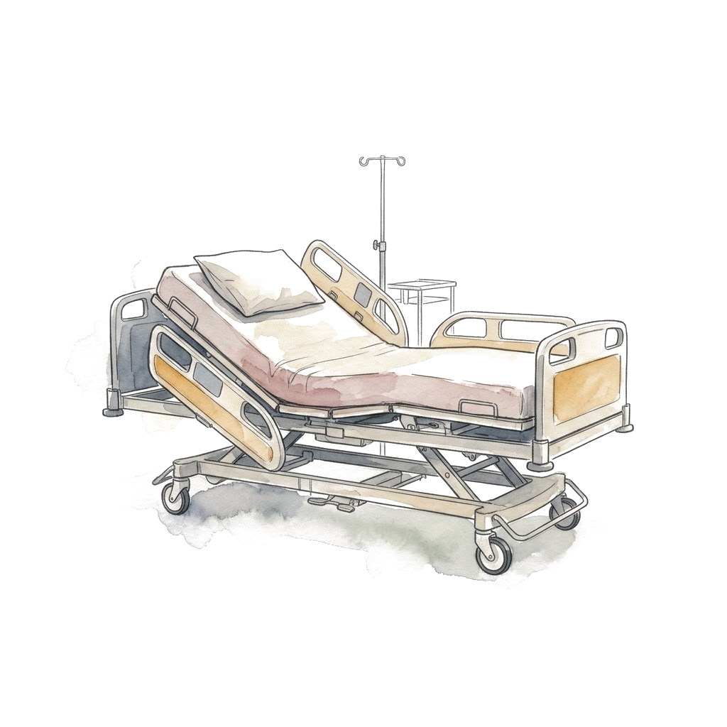
Protecting the brain: every patient with grade III-IV
Head of bed 30°, neck neutral
Treat fever, avoid hypoglycemia
Sodium 145 to 155 mmol/L with hypertonic saline (use your center's protocol)
Avoid fluid overload
Treat seizures, EEG if in doubt. No routine prophylaxis
No cooling: 34 °C did not prevent intracranial hypertension in an RCT
SCCM 2023 [PMID: 37052436]; update 2022 [PMID: 36001996]; Bernal W et al. J Hepatol 2016;65:273-9
Notes:
Sodium targets differ between sources: the 2022 update uses 145 to 155 for prevention, the 2024 practical review a lower range. Agree on one with transplant hepatology and write it in the orders. Hypertonic saline is a conditional SCCM recommendation for patients at risk of intracranial hypertension. The cooling trial randomized intubated high-risk ALF patients to 34 vs 36 °C for 72 hours; no difference in intracranial hypertension or survival. Avoid fever, don't induce hypothermia.

Slide 39
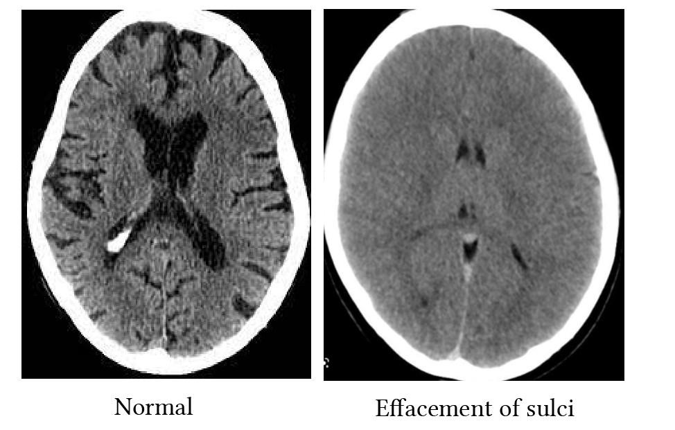
A surge: new hypertension, bradycardia or a pupil
Hyperosmolar bolus (hypertonic saline or mannitol)
Brief hyperventilation as a bridge
Call the transplant team now
Things to know
Hypertension and bradycardia come late. Don't wait for them
A normal head CT does not exclude raised ICP
ICP monitors are not routine; SCCM suggests against (very low certainty)
SCCM 2023 [PMID: 37052436]; practical update 2024 [PMID: 39170946]
Notes:
A new pupil asymmetry or a sudden change in the exam is enough to act. Treat first, then image if a bleed or another structural lesion is possible.

Slide 40
The creatinine is only 1.3
Ammonia 182 → 214 μmol/L, grade III, urine output 15 mL/h
Do you wait for a conventional dialysis indication?
Notes:
Ask them. Nephrology will often say the creatinine doesn't meet criteria. That's the wrong frame for ALF.

Slide 41
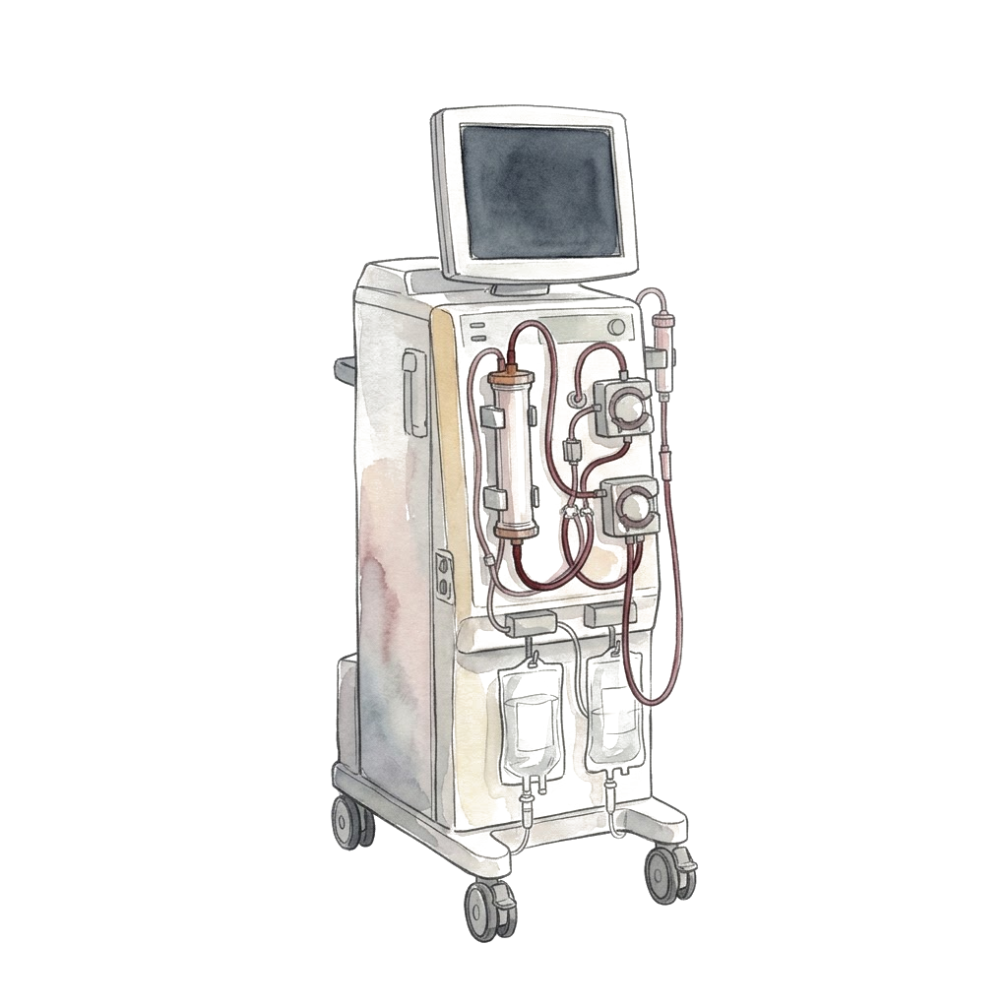
The creatinine is only 1.3
Ammonia 182 → 214 μmol/L, grade III, urine output 15 mL/h
No. In ALF, start CRRT for the ammonia
ACG 2023: suggests early CRRT for hyperammonemia with grade II or higher encephalopathy, even without a renal indication (conditional, very low certainty)
Continuous, not intermittent: fewer swings in blood pressure and brain water
Call nephrology now
ACG ALF guideline 2023 [PMID: 37377263]; update 2022 [PMID: 36001996]
Notes:
Ammonia around 150 to 200 is a high-risk context in the literature, not a universal threshold. Look at the trajectory and the neuro exam. Coordinate the CRRT fluid with the sodium plan or the dialysis will pull her sodium back down.

Slide 42
Should we correct this INR?
Hour 12: INR 4.1, platelets 88,000. She needs a dialysis catheter
2 units of FFP first?
Notes:
Hour 12, CRRT is starting. Very common request from the procedure side.

Slide 43
Should we correct this INR?
Hour 12: INR 4.1, platelets 88,000. She needs a dialysis catheter
No plasma just to fix the number
The INR sees only the procoagulant side. Protein C and S are low too, factor VIII and von Willebrand factor are high. Most patients are rebalanced
Plasma adds volume (lungs, brain) and erases the INR trend that prognosis and listing rely on
What to do instead
Ultrasound-guided line, experienced operator, compressible site
Vitamin K once; check fibrinogen and platelets; viscoelastic testing if available
Treat bleeding. Plan high-risk procedures (like an ICP monitor) separately
Update 2022 [PMID: 36001996]; SCCM 2020 [PMID: 32058387]
Notes:
The INR is a great marker of liver function and a poor marker of bleeding risk in ALF. Spontaneous bleeding is uncommon. Ask transplant hepatology before giving plasma: they need the native INR.

Slide 44
Rebalanced hemostasis
Favors bleeding
Low factors II, V, VII, IX, X
Low fibrinogen when severe
Low platelets
Favors clotting
Low protein C and protein S
Low antithrombin
High factor VIII and von Willebrand factor
The INR sees part of this side
The INR doesn't see this side
Balanced in most patients, but easily tipped either way: both bleeding and thrombosis happen
Concept from Lisman T, Porte RJ. Blood 2010
Notes:
Both sides go down together. The INR only tests the left pan, so it makes the patient look much more anticoagulated than she is. Viscoelastic tests look at clot formation in whole blood and in ALF are often close to normal despite a high INR, though they miss the endothelium and the protein C system too. The balance is fragile: infection, kidney failure and procedures tip it, and thrombosis, including line-related clots, is real.

Slide 45
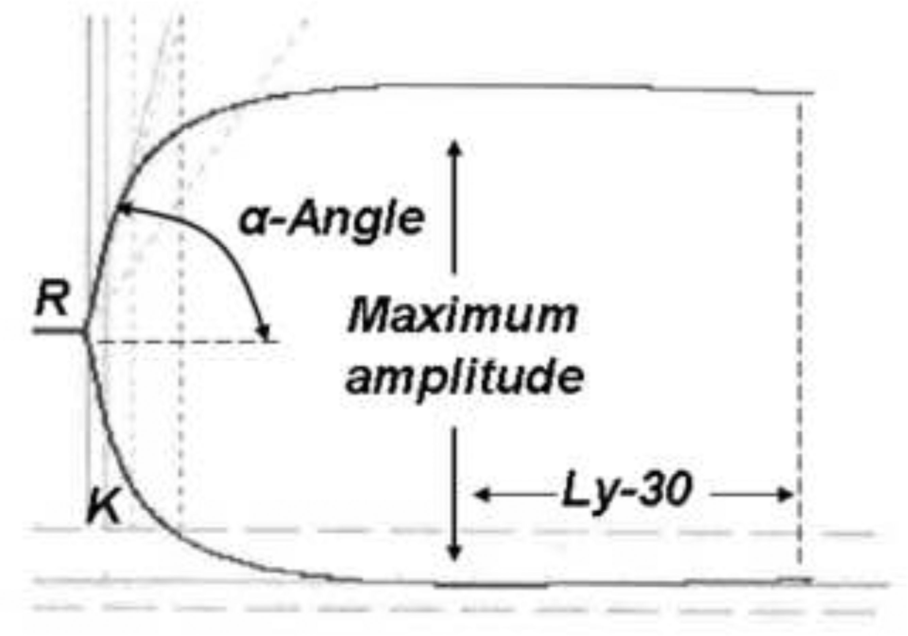
INR 4.2. What does the TEG say?
Stravitz RT et al. J Hepatol 2012;56:129-36 [PMID: 21703173]
Notes:
51 patients with acute liver injury or failure, mean INR 3.4. Mean TEG values were normal, and all five TEG parameters were normal in 63%. Low clot strength showed up only with platelets under about 126,000. Factors V and VII were low, but so were the anticoagulant proteins, and factor VIII was high.

Slide 46
INR 4.2. What does the TEG say?
Normal in all five TEG measures, in a patient with ALF and an INR of 4.2
Stravitz RT et al. J Hepatol 2012;56:129-36 [PMID: 21703173]
Notes:
51 patients with acute liver injury or failure, mean INR 3.4. Mean TEG values were normal, and all five TEG parameters were normal in 63%. Low clot strength showed up only with platelets under about 126,000. Factors V and VII were low, but so were the anticoagulant proteins, and factor VIII was high.

Slide 47
CRRT for ammonia: what to agree on with nephrology
 | What to watch and say
Why | It's for the ammonia and the brain, not the creatinine. Give them the HE grade, the ammonia trend, urine output and fluid status
Dose | Prescribed vs delivered. Filter clotting and downtime mean less clearance, and the ammonia climbs back. Recheck it
Sodium | One plan for replacement fluid or dialysate, hypertonic saline and every other sodium source. Check the sodium often
Safety | Phosphate and potassium fall. Blood pressure drops at connection. Anticoagulation per your protocol; citrate can build up in liver failure, so follow the total to ionized calcium ratio
ACG ALF 2023 [PMID: 37377263]; Cardoso FS et al. Hepatology 2018 [PMID: 28859230]; update 2022 [PMID: 36001996]
Notes:
No universal dose or ammonia target to stop at; use your center's protocol. The common failure is not the decision to start, it's a circuit that keeps clotting so the delivered clearance is a fraction of what was ordered, and a sodium plan that nobody owns.

Slide 48
I know what you're thinking...
Notes:
Pause. Someone in the room has heard it from nephrology.

Slide 49
"CVVH doesn't clear ammonia"
True or false?

Slide 50
"CVVH doesn't clear ammonia"
Ammonia is tiny (17 Da), water soluble and not protein bound
It crosses the filter with the water (convection, CVVH) or down its gradient (diffusion, CVVHD)
So what matters is effluent flow and hours on a working circuit, not the letters
More effluent, more clearance: 90 vs 35 mL/kg/h (Slack 2014)
54 ALF patients on CRRT: median ammonia 151 → 52 μmol/L by day 5 (Warrillow 2020)
It does. About half the clearance of urea, so dose and filter life matter
Fisher C et al. Blood Purif 2022 [PMID: 35042216]; Warrillow SJ et al. Crit Care Med 2020 [PMID: 31939790]; Slack AJ et al. Liver Int 2014
Notes:
You will hear this from nephrology. The physiology says otherwise: ammonia is a small, unbound, water-soluble molecule, and it moves across a high-flux filter with convection as well as diffusion. In Fisher's study of 12 patients with liver failure the three modalities gave similar ammonia clearance at the same effluent rate (no significant difference), and in the same patients urea clearance was about 50 mL/min and creatinine 42, so ammonia clears less well than urea but clearly clears. Why the doubt? The liver and the muscle keep making it, so the level falls slowly; a clotting circuit with a lot of downtime delivers much less than what was ordered; and at low effluent doses the effect is small. In Warrillow's cohort the fall tracked how long patients were on CRRT more than the hourly dose. Ask for a high effluent rate and an anticoagulation plan that keeps the filter running.

Slide 51
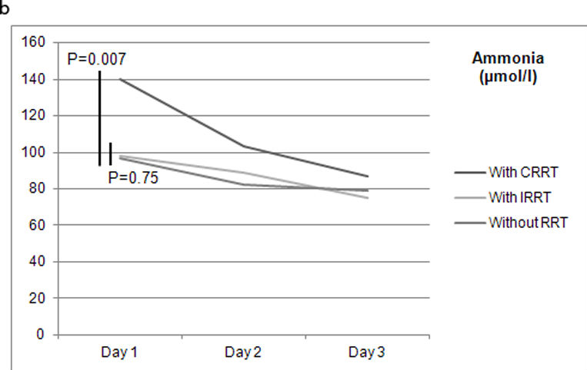
Does early CRRT actually help?
Cardoso FS et al. Hepatology 2018;67:711-20 [PMID: 28859230]
Notes:
US ALF Study Group registry, 1,186 patients. Panel b of their Figure 1. The CRRT patients started higher, which is why they got CRRT. Observational, so it shows ammonia comes down on CRRT, not that CRRT saved them.

Slide 52
Does early CRRT actually help?
Ammonia fell from about 140 to under 90 μmol/L over 3 days on CRRT. Little change with intermittent RRT or no RRT
Cardoso FS et al. Hepatology 2018;67:711-20 [PMID: 28859230]
Notes:
US ALF Study Group registry, 1,186 patients. Panel b of their Figure 1. The CRRT patients started higher, which is why they got CRRT. Observational, so it shows ammonia comes down on CRRT, not that CRRT saved them.

Slide 53
Does early CRRT actually help?
 | US ALF Study Group cohort (2018) | Pilot RCT (2026)
Design | Large registry, observational | Open label, ALF with cerebral edema; both arms got plasma exchange
Comparison | CRRT vs no CRRT | CRRT within 12 hours vs CRRT only if plasma exchange failed
Finding
Catch
Cardoso FS et al. Hepatology 2018 [PMID: 28859230]; Aliment Pharmacol Ther 2026 [PMID: 42332991]
Notes:
The 2026 trial is interesting but don't oversell it. The early mortality signal is real in the abstract; 28-day survival by intention to treat was comparable, and the per-protocol analysis is biased by crossovers. Read the full methods before quoting more numbers.

Slide 54
Does early CRRT actually help?
 | US ALF Study Group cohort (2018) | Pilot RCT (2026)
Design | Large registry, observational | Open label, ALF with cerebral edema; both arms got plasma exchange
Comparison | CRRT vs no CRRT | CRRT within 12 hours vs CRRT only if plasma exchange failed
Finding | CRRT linked to lower ammonia and better 21-day transplant-free survival | Primary endpoint, 28-day survival: similar by intention to treat. Fewer deaths in the first 7 days (2.2% vs 17.8%)
Catch | Association. Sicker or healthier patients may have been picked for CRRT | Small pilot, one center, many protocol violations. Needs a larger trial
Cardoso FS et al. Hepatology 2018 [PMID: 28859230]; Aliment Pharmacol Ther 2026 [PMID: 42332991]
Notes:
The 2026 trial is interesting but don't oversell it. The early mortality signal is real in the abstract; 28-day survival by intention to treat was comparable, and the per-protocol analysis is biased by crossovers. Read the full methods before quoting more numbers.

Slide 55
Day 3: the enzymes are falling
Is she getting better?
Notes:
Show only the enzymes. Most of the room will say yes.

Slide 56
Day 3: the enzymes are falling
Day 2 arterial pH 7.26 after fluids
No. The INR, the lactate and her brain are all worse
Made-up numbers for teaching
Notes:
Falling AST and ALT don't prove recovery. A rising INR, rising lactate and worse encephalopathy mean she is getting worse despite lower enzymes. One explanation is that there is little liver left to release them; shock and other causes also push the lactate up. Read the whole trajectory, not one line [PMID: 36001996]. Point out the day 2 arterial pH of 7.26 after fluids. It comes back on the King's College slide.

Slide 57

When do you call transplant hepatology?
When she meets King's College criteria?
When MELD is high enough?
Notes:
Let them vote.

Slide 58
When do you call transplant hepatology?
You should have called on admission, when you first suspected ALF
King's College criteria predict death without transplant. They are specific, not sensitive
They are not a referral threshold. If you wait for them, the evaluation starts too late
Patient A: arterial pH 7.26 on day 2 after fluids. She now meets the acetaminophen criteria
O'Grady 1989 criteria, as summarized in EASL 2017 [PMID: 28417882]; full criteria in the appendix
Notes:
King's College criteria are specific but not very sensitive. If you wait for them, the evaluation starts too late. Patient A now meets acetaminophen criteria by pH, but the call happened on admission. Transplant referral, listing and allocation are separate decisions; the transplant team handles the last two.

Slide 59
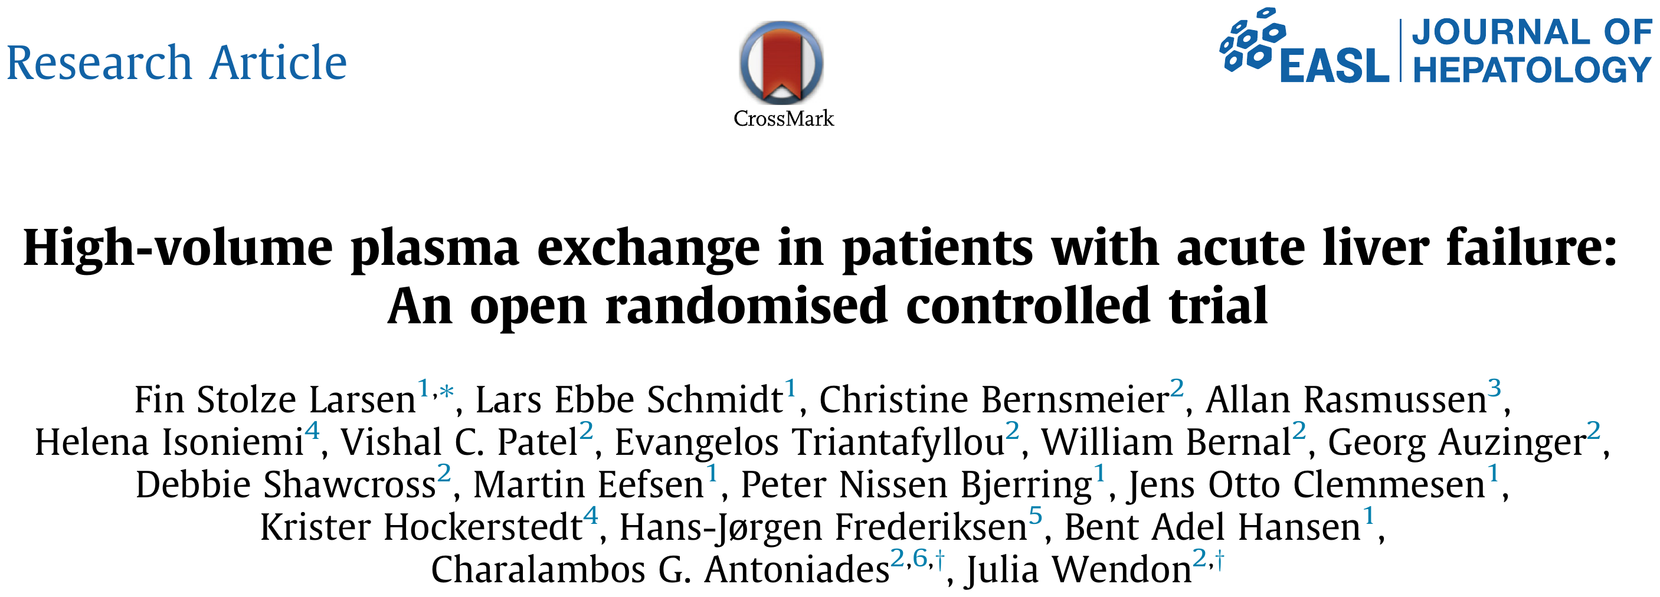
Can plasma exchange buy time?
What do you think they found?
Larsen FS et al. J Hepatol 2016;64:69-78 [PMID: 26325537]

Slide 60
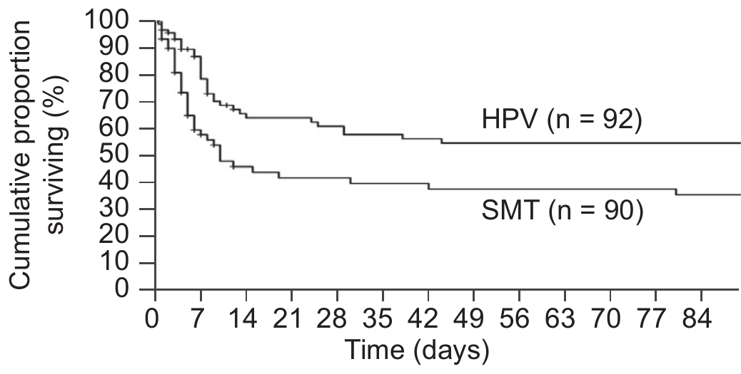
Can plasma exchange buy time?
Larsen FS et al. J Hepatol 2016;64:69-78 [PMID: 26325537]
Notes:
Their Figure 1: hospital survival, high-volume plasma exchange (HPV) vs standard medical treatment (SMT), log-rank p = 0.0058.

Slide 61
Can plasma exchange buy time?
Study | Open randomized trial, ALF, high-volume plasma exchange for 3 days vs standard care, 182 patients
Main finding | Hospital survival 58.7% vs 47.8% (HR 0.56); best in patients who were not transplanted
What it doesn't show
So
Larsen FS et al. J Hepatol 2016 [PMID: 26325537]
Notes:
High-volume plasma exchange removes cytokines and DAMPs and replaces coagulation factors. Note the INR after plasma exchange is no longer the patient's INR.

Slide 62
Can plasma exchange buy time?
Study | Open randomized trial, ALF, high-volume plasma exchange for 3 days vs standard care, 182 patients
Main finding | Hospital survival 58.7% vs 47.8% (HR 0.56); best in patients who were not transplanted
What it doesn't show | Not blinded; one regimen in one population. Says nothing about ACLF or about albumin dialysis devices
So | A bridge to discuss with transplant hepatology. Not a reason to delay listing
Larsen FS et al. J Hepatol 2016 [PMID: 26325537]
Notes:
High-volume plasma exchange removes cytokines and DAMPs and replaces coagulation factors. Note the INR after plasma exchange is no longer the patient's INR.

Slide 63
Let's recap: bed 4, day 3
Problem | What she's on | What we watch
Acetaminophen ALF, meets King's (pH 7.26) | NAC. Listed status 1A on day 2 | Time to an offer
Grade III-IV encephalopathy, ammonia 182 | Intubated, normal CO2, sodium 145 to 155, CRRT | Pupils, ammonia on CRRT, sodium
Lactate 5.8 and rising | Volume and MAP, look for infection | Lactate, MAP, pressor need
INR 5.6, not bleeding | No plasma | Bleeding, INR trend
Infection risk | Surveillance cultures | New fever or shock: low bar for antibiotics and antifungals
Made-up numbers for teaching
Notes:
This is where she is while she waits. What would close the window: fixed dilated pupils, uncontrolled sepsis, rising support despite everything. If she becomes hypotensive: norepinephrine first, vasopressin next, hydrocortisone if refractory, and keep the MAP high enough for cerebral perfusion. Status 1A is the OPTN category for ALF in the ICU; check current policy before quoting details.

Slide 64

Any questions so far?

Slide 65
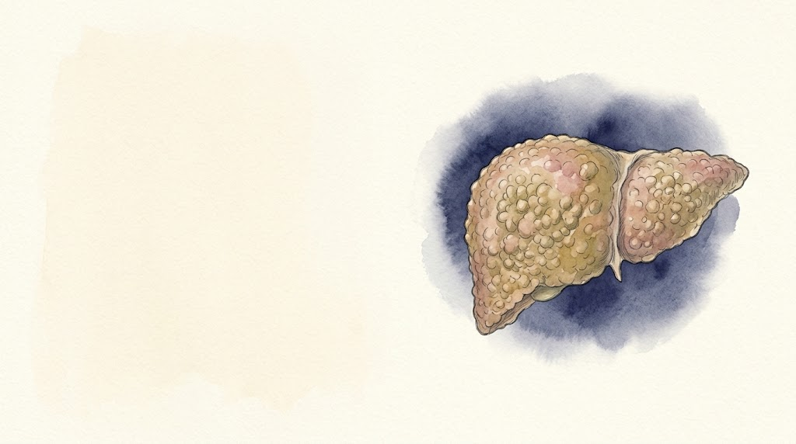
Bed 7
56M, cirrhosis and ACLF
Notes:
Second patient, in the unit at the same time.

Slide 66
Back to day 1: bed 7
Bed 4 | Bed 7
28-year-old woman | 56-year-old man
Acetaminophen ALF | Alcohol-related cirrhosis with ascites
Intubated, on CRRT, transplant hepatology involved | Fever, confusion, low blood pressure
Is this liver failure too?
Notes:
While bed 4 is going on, the nurse from bed 7 calls: his pressure is 82/46. Same day, same unit, a sick liver again. Let them guess before the next slide whether this is the same disease.

Slide 67
56M, cirrhosis and fever
Alcohol-related cirrhosis, ascites on diuretics; last drink 3 weeks ago
Temp 38.4 °C, HR 112, BP 82/46
RR 26, SpO2 92% on a 35% Venturi mask; PaO2 74
Confused, asterixis (grade II)
Urine output 15 mL/h
 | Now | Baseline
Bilirubin (mg/dL) | 5.8 | 2.1
INR | 2.1 | 1.6
Creatinine (mg/dL) | 2.6 | 0.9
Sodium (mmol/L) | 127 | 133
WBC (/μL) | 16,200
Platelets (/μL) | 62,000
Lactate (mmol/L) | 3.9
What's your next step?
Notes:
Made-up patient. Same day, bed 7. After 2 L of fluid he is on norepinephrine 0.15 mcg/kg/min.

Slide 68
56M, cirrhosis and fever
Alcohol-related cirrhosis, ascites on diuretics; last drink 3 weeks ago
Temp 38.4 °C, HR 112, BP 82/46
RR 26, SpO2 92% on a 35% Venturi mask; PaO2 74
Confused, asterixis (grade II)
Urine output 15 mL/h
 | Now | Baseline
Bilirubin (mg/dL) | 5.8 | 2.1
INR | 2.1 | 1.6
Creatinine (mg/dL) | 2.6 | 0.9
Sodium (mmol/L) | 127 | 133
WBC (/μL) | 16,200
Platelets (/μL) | 62,000
Lactate (mmol/L) | 3.9
What's your next step?
Find the source: cultures, antibiotics, a diagnostic tap
Notes:
Same as bed 4: treat first, label later. We'll count organs once the antibiotics are in.

Slide 69
What tipped him over?
INR 2.1, platelets 62,000. Do you tap him?
Notes:
Ask what tipped him over before showing the answer. Then the procedural question: people hesitate to tap a coagulopathic patient.

Slide 70
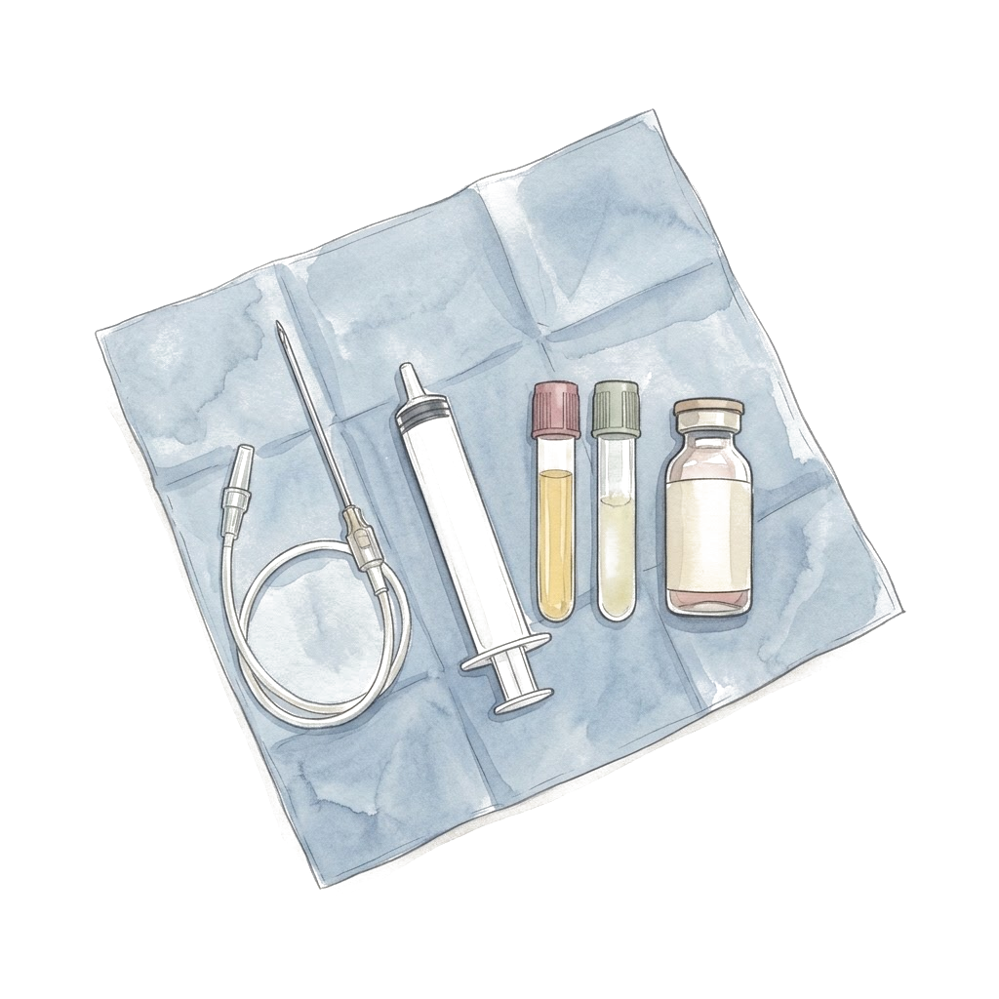
What tipped him over?
Yes, now. No plasma, no platelets
Ascitic fluid: PMN 1,240/mm³. Spontaneous bacterial peritonitis
Common triggers
Infection: SBP, pneumonia, urine, lines, C. difficile
Alcohol-associated hepatitis
GI bleeding
Drugs: NSAIDs, sedatives, too much diuretic
HBV flare, ischemia
No trigger is found in some patients. Repeat the search if he gets worse
EASL ACLF 2023 [PMID: 37364789]; SCCM 2023 [PMID: 37052436]
Notes:
Diagnostic paracentesis is low risk and should not wait for correction of the INR or platelets. Infection is the most common precipitant of ACLF in Western cohorts.

Slide 71
Why is he hypotensive?
Mechanism | What you do
Surviving Sepsis 2026 [PMID: 41869847]; SCCM 2020 [PMID: 32058387]; EASL ACLF 2023 [PMID: 37364789]
Notes:
Albumin is a reasonable resuscitation fluid in cirrhosis, but every bag goes somewhere. Keep that in mind for the next few slides.

Slide 72
Why is he hypotensive?
Mechanism | What you do
Sepsis (SBP) | Cultures, antibiotics in the first hour, source control. Cover for prior exposure and local resistance
Splanchnic vasodilation of cirrhosis | Norepinephrine. Start at MAP 65 and adjust to perfusion
Too little volume, or too much | Ultrasound and dynamic measures. Edema does not mean the vessels are full
Hidden bleeding | Hemoglobin, rectal exam, think varices
Relative adrenal insufficiency | Hydrocortisone if shock is refractory
Cirrhotic cardiomyopathy | Echo
Usually more than one of these
Surviving Sepsis 2026 [PMID: 41869847]; SCCM 2020 [PMID: 32058387]; EASL ACLF 2023 [PMID: 37364789]
Notes:
Albumin is a reasonable resuscitation fluid in cirrhosis, but every bag goes somewhere. Keep that in mind for the next few slides.

Slide 73
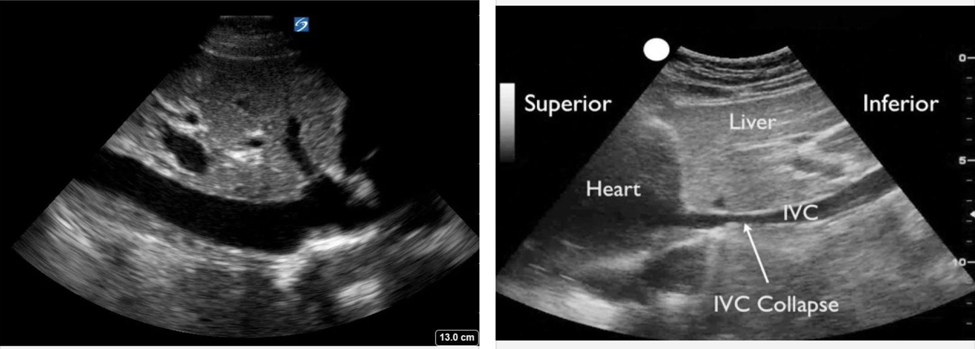
Too little volume, or too much?
Which one would you give more fluid?

Slide 74
Too little volume, or too much?
Left: a full, plethoric IVC. Right: an IVC that collapses
Look before you give the next liter
Notes:
Ascites and a tense belly change IVC size and collapse, so use it with the lungs, the heart and the trend, not alone. Edema in a cirrhotic doesn't mean the vessels are full.

Slide 75
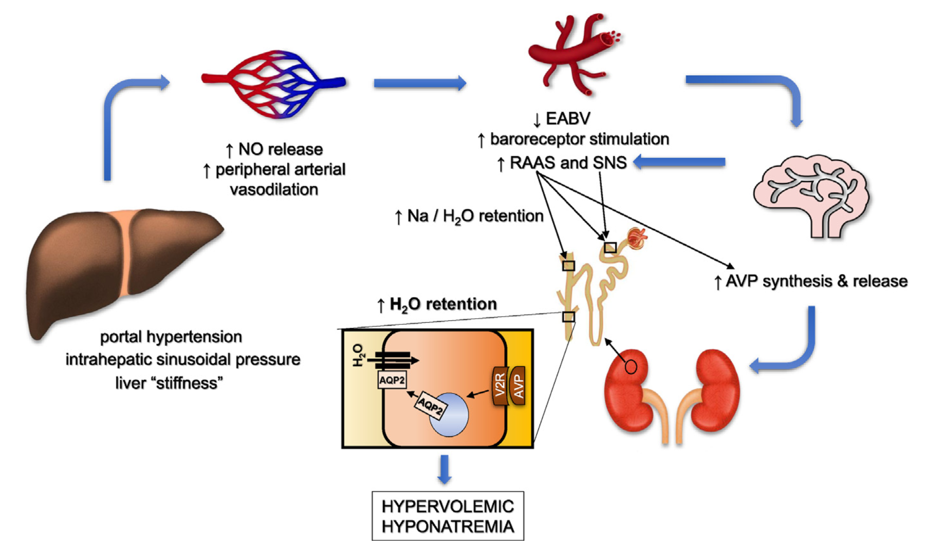
Why is his pressure low to begin with?
Rondon-Berrios H, Velez JCQ. Clin Liver Dis 2022
Notes:
Portal hypertension, nitric oxide, splanchnic vasodilation, a low effective arterial volume, then RAAS, sympathetic tone and vasopressin. That's his baseline MAP, his sodium of 127 and his kidney, before the infection even started.

Slide 76
ALF, decompensation or ACLF?
 | Acute liver failure | Acute decompensation | ACLF
Liver before
What defines it
What usually kills
ICU focus
Transplant
EASL ALF 2017 [PMID: 28417882]; EASL ACLF 2023 [PMID: 37364789]
Notes:
Patient A is in the first column, patient B in the last. The words sound alike; the ICU problems are different.

Slide 77
ALF, decompensation or ACLF?
 | Acute liver failure | Acute decompensation | ACLF
Liver before | No cirrhosis | Cirrhosis | Cirrhosis (or chronic liver disease, depending on definition)
What defines it | INR ≥ 1.5 + encephalopathy | Ascites, bleeding, encephalopathy, jaundice | Decompensation + organ failure
What usually kills | Brain, multiorgan failure, sepsis | Bleeding, infection. Can turn into ACLF | Infection, shock, multiorgan failure
ICU focus | Brain, ammonia, early CRRT | Treat the trigger | Source control, shock, kidney vs lung
Transplant | Urgent listing pathway | Refer when MELD or the complication calls for it | Narrow window; reassess daily
EASL ALF 2017 [PMID: 28417882]; EASL ACLF 2023 [PMID: 37364789]
Notes:
Patient A is in the first column, patient B in the last. The words sound alike; the ICU problems are different.

Slide 78
Count the failing organs
Organ | Failure (EASL-CLIF)
Liver | Bilirubin ≥ 12 mg/dL
Kidney | Creatinine ≥ 2.0 mg/dL or on RRT
Brain | Encephalopathy grade III-IV
Coagulation | INR ≥ 2.5
Circulation | Vasopressors (or terlipressin)
Lungs | PaO2/FiO2 ≤ 200, SpO2/FiO2 ≤ 214, or ventilated (not for encephalopathy)
CLIF-C organ failure score, EASL ACLF 2023 [PMID: 37364789]; CANONIC [PMID: 23474284]
Notes:
Have the room count with you. Liver failure here means a bilirubin of 12, which surprises people.

Slide 79
Count the failing organs
Organ | Failure (EASL-CLIF) | Patient B
Liver | Bilirubin ≥ 12 mg/dL | 5.8: no
Kidney | Creatinine ≥ 2.0 mg/dL or on RRT | 2.6: yes
Brain | Encephalopathy grade III-IV | Grade II: no
Coagulation | INR ≥ 2.5 | 2.1: no
Circulation | Vasopressors (or terlipressin) | Norepinephrine: yes
Lungs | PaO2/FiO2 ≤ 200, SpO2/FiO2 ≤ 214, or ventilated (not for encephalopathy) | PaO2/FiO2 211: no
Two organ failures: ACLF grade 2
CLIF-C organ failure score, EASL ACLF 2023 [PMID: 37364789]; CANONIC [PMID: 23474284]
Notes:
Kidney and circulation. Respiratory is borderline: PaO2 74 on a Venturi mask at 0.35 is a P/F of 211. That's why he's on a Venturi mask here: nasal cannula doesn't give you a reliable FiO2, so if the grade depends on the lungs, get a gas on a known FiO2. Watch that row.

Slide 80
ACLF grades
Grade | What it takes
No ACLF | No organ failure; or one failure of liver, clotting, circulation or lungs, with creatinine < 1.5 and no HE; or brain failure alone, with creatinine < 1.5
ACLF 1 | Kidney failure alone; or one failure of liver, clotting, circulation or lungs, with creatinine 1.5 to 1.9 and/or grade I-II HE; or brain failure alone, with creatinine 1.5 to 1.9
ACLF 2 | Two organ failures
ACLF 3 | Three or more
A patient with "no ACLF" can still be very sick. Use the CLIF-C calculator
Moreau R et al. Gastroenterology 2013 [PMID: 23474284]; EASL ACLF 2023 [PMID: 37364789]
Notes:
Grade 1 is the confusing one: kidney failure alone counts, but a single other organ failure counts only with some kidney dysfunction, or mild encephalopathy for the non-brain organs. Brain failure alone needs the creatinine of 1.5 to 1.9. A patient with grade III HE and a normal creatinine is 'no ACLF' by this system, and can still be very sick. Use the CLIF-C calculator rather than memorizing it. The grade at days 3 to 7 says more than the grade at admission.

Slide 81
28-day mortality by ACLF grade
CANONIC, 1,343 patients, 2013
Moreau R et al. Gastroenterology 2013 [PMID: 23474284]
Notes:
Patient B is grade 2 on day 1. That is a group number from a 2013 cohort, not his number. The jump to grade 3 is the one to remember. The grade at days 3 to 7 says more than the grade at admission, which comes back later.

Slide 82
Why do the organs fail?
Trigger: SBP
Bacterial products and damaged-cell signals (PAMPs, DAMPs)
Systemic inflammation, cytokine storm
Organ failure
Immune paralysis, mitochondrial failure
Worse vasodilation on top of portal hypertension
Bed 7 so far: kidney and circulation. Lungs and brain are next in line
Treat the trigger early and support the organs; there is no drug for the inflammation itself
Concept from Arroyo V, Moreau R, Jalan R. N Engl J Med 2020
Notes:
ALF had its 'why does the brain swell'. This is the ACLF version. The precipitant sets off systemic inflammation in a patient who is already vasodilated, and the organs fail from a mix of low perfusion, inflammation and mitochondrial dysfunction. The patient is both inflamed and immunosuppressed, which is why second infections are common.

Slide 83
Does he have HRS?
12 hours later: creatinine 3.0, urine 10 mL/h, still on norepinephrine
HRS? Start terlipressin?
Notes:
The reflex in many units: oliguric cirrhotic, give albumin for 48 hours, then terlipressin.

Slide 84
HRS-AKI: what changed in 2024
What many of us learned (ICA 2015) | Now (ADQI-ICA 2024)
No response after 2 days of diuretic withdrawal and albumin 1 g/kg No shock No nephrotoxins, no structural kidney disease | Cirrhosis with ascites AKI by creatinine and/or urine output No improvement within 24 hours of volume resuscitation, if he needs it No albumin challenge if he is already euvolemic or wet No strong alternative explanation as the main cause
Faster to call. But you still have to look for the other causes
Angeli P et al. J Hepatol 2015 (ICA); ADQI-ICA consensus, J Hepatol 2024 [PMID: 38527522]
Notes:
The left column is what most of us were taught. The 48-hour albumin challenge is gone, and there is no fluid challenge at all for a patient who is already wet.

Slide 85
Does he have HRS?
12 hours later: creatinine 3.0, urine 10 mL/h, still on norepinephrine
HRS-AKI (ADQI-ICA 2024) | Bed 7, day 1
Cirrhosis with ascites
AKI by creatinine and/or urine output
No improvement within 24 hours of volume resuscitation, if he needs it
No strong alternative explanation (shock, nephrotoxins, structural injury)
Go down the list for him. Which boxes does he tick?
ADQI-ICA consensus, J Hepatol 2024 [PMID: 38527522]
Notes:
Let the room fill it in.

Slide 86
Does he have HRS?
12 hours later: creatinine 3.0, urine 10 mL/h, still on norepinephrine
HRS-AKI (ADQI-ICA 2024) | Bed 7, day 1
Cirrhosis with ascites | Yes | ✅
AKI by creatinine and/or urine output | Creatinine 0.9 → 3.0, urine 10 mL/h | ✅
No improvement within 24 hours of volume resuscitation, if he needs it | 2 L given on arrival. Too early to say | ❌
No strong alternative explanation (shock, nephrotoxins, structural injury) | Septic shock on norepinephrine | ❌
Not HRS yet. Treat the shock first
ADQI-ICA consensus, J Hepatol 2024 [PMID: 38527522]
Notes:
AKI here means creatinine up 0.3 mg/dL or more within 48 hours, or 50% or more within 7 days, and/or urine output 0.5 mL/kg/h or less for 6 hours or more. The mandatory 48-hour albumin challenge is gone, and a patient who is already wet doesn't need a fluid challenge to satisfy a clock. HRS physiology and tubular injury can coexist. Assessment is faster and individualized. But that cuts both ways: you also need to look for the other causes, and right now sepsis is the obvious one.

Slide 87
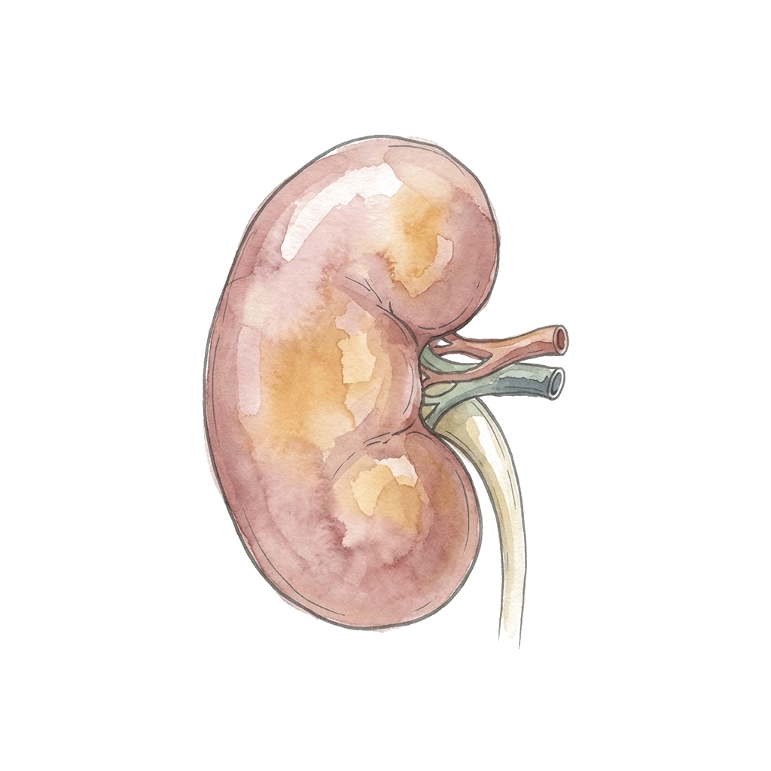
Kidney failure in cirrhosis is usually a mixture
Possible contributors
Low effective volume
Tubular injury: sepsis, contrast, drugs
HRS physiology
Tense ascites (abdominal compartment)
Congestion
Look
Urinalysis and sediment
Drug list
Ultrasound: kidneys, bladder, IVC, heart, lungs
Bladder pressure if the belly is tight
A low urine sodium is not proof of HRS
ADQI-ICA consensus 2024 [PMID: 38527522]
Notes:
These coexist and change over the admission. A diagnosis of HRS made on day 1 should be re-examined on day 2.

Slide 88
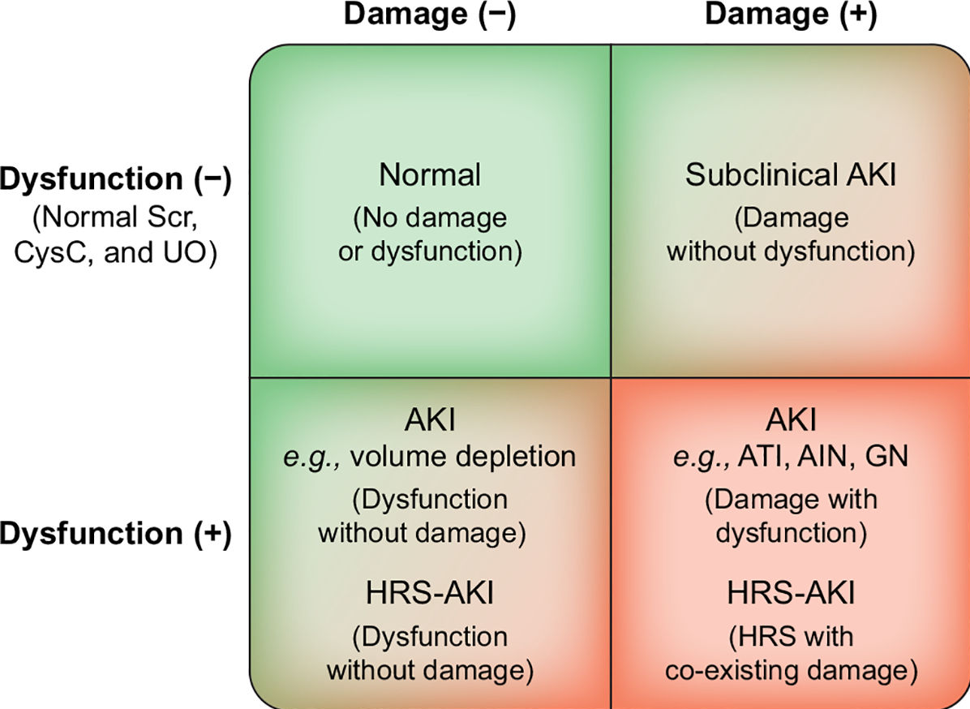
Function and damage: four kinds of AKI
Nadim MK et al. J Hepatol 2024;81:163-83 [PMID: 38527522], Fig. 4 (CC BY 2.0, adapted from ADQI)
Notes:
HRS-AKI sits in the bottom row: dysfunction, with or without damage. ATN and HRS can coexist. Damage markers such as urine NGAL help where available; a urine sediment helps everywhere.

Slide 89
Day 1: more confused
More disoriented, pulling at his lines, asterixis. Awake, follows commands
The nurse sent an ammonia: 88 μmol/L
More lactulose? Repeat the ammonia in 6 hours?
Notes:
The reflex is to give more lactulose and recheck the ammonia. Let them say it.

Slide 90
Day 1: more confused
More disoriented, pulling at his lines, asterixis. Awake, follows commands
The nurse sent an ammonia: 88 μmol/L
Look for the reason first. The ammonia doesn't tell you
Glucose, sodium, oxygen and CO2
Is the infection controlled? Cultures, source, antibiotic coverage
Bleeding, sedatives and opioids, withdrawal, seizures, a new focal deficit (CT head)
Lactulose for overt HE: 2 to 3 soft stools a day. By tube if he can't swallow safely; watch for dehydration and high sodium
Rifaximin is an add-on, mainly to prevent the next episode
Grade III-IV and a poor airway: intubate
No repeat ammonia
EASL HE guideline 2022 [PMID: 35724930]; SCCM 2023 [PMID: 37052436]
Notes:
In cirrhosis, HE is a clinical diagnosis. The ammonia level doesn't grade it, and chasing it doesn't help. Every worsening needs the same search for a precipitant as the admission did. Lactulose is right for overt HE, but too much gives you dehydration, hypernatremia and a worse kidney. Don't make every first episode an automatic two-drug start.

Slide 91
Day 2: worse kidney, worse lungs
 | Admission | Day 2
Albumin received |  | 110 g (SBP dose, 1.5 g/kg at 73 kg) + 2 L crystalloid
Breathing | SpO2 92%, Venturi 35% | SpO2 86% on Venturi 50%, RR 32, crackles
Ultrasound |  | Diffuse B-lines, IVC full
Creatinine (mg/dL) | 2.6 | 3.1
Urine output | 15 mL/h | 10 mL/h
Norepinephrine (mcg/kg/min) | 0.15 | 0.22
More albumin? Terlipressin? Something else?
Notes:
This is the hinge of the second case. The kidney is worse, and the reflex is to treat the kidney.

Slide 92
Day 2: worse kidney, worse lungs
 | Admission | Day 2
Albumin received |  | 110 g (SBP dose, 1.5 g/kg at 73 kg) + 2 L crystalloid
Breathing | SpO2 92%, Venturi 35% | SpO2 86% on Venturi 50%, RR 32, crackles
Ultrasound |  | Diffuse B-lines, IVC full
Creatinine (mg/dL) | 2.6 | 3.1
Urine output | 15 mL/h | 10 mL/h
Norepinephrine (mcg/kg/min) | 0.15 | 0.22
First, what are the lungs telling you?
Now on high-flow, FiO2 0.6, SpO2 90%: SpO2/FiO2 150. That's a third organ failure
Notes:
Kidney, circulation and now lungs: ACLF grade 3. Fluid and albumin are a likely part of this, with B-lines and a full IVC. But think about pneumonia, ARDS and the heart too before you decide it's all volume.

Slide 93
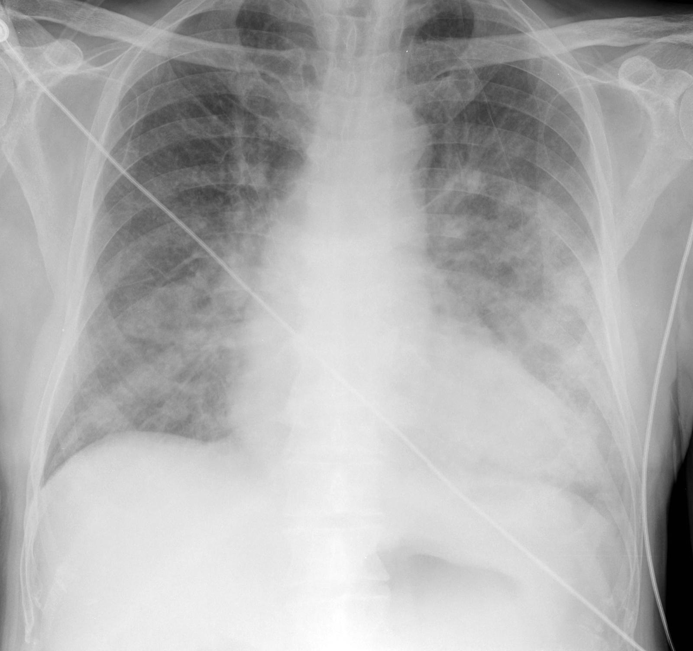
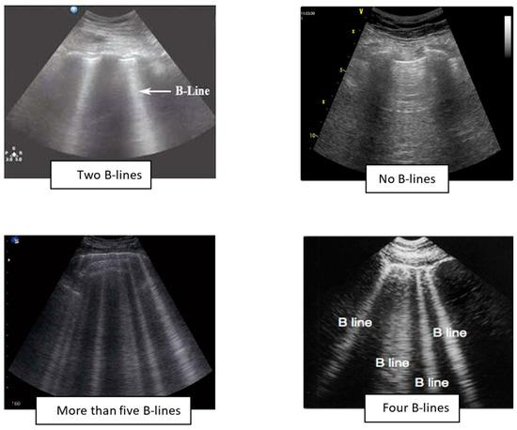
Day 2: what do his lungs look like?
Images for teaching, not this patient
Notes:
Bilateral airspace disease on the film and many B-lines on ultrasound: water in the lungs. It could still be pneumonia or ARDS, so look at the whole picture before you call it all volume.

Slide 94
Will fixing the kidney hurt the lungs?
Terlipressin, more albumin, dialysis: what would you do for him today?

Slide 95
Will fixing the kidney hurt the lungs?
Terlipressin: not for him today
  Label: contraindicated with hypoxia or worsening respiratory symptoms; don't start if SpO2 < 90%, stop if it falls below 90%
  Label: avoid in ACLF grade 3; volume overload raises the risk of respiratory failure
Stop the albumin while he is wet
He is already on a vasoconstrictor. Norepinephrine, titrated to perfusion
RRT if he stays overloaded. For HRS, RRT is a bridge to transplant: if he isn't a candidate, talk about goals before you start
Midodrine and octreotide? They work poorly, and not in someone on IV pressors
Check oxygen and volume before any kidney treatment
TERLIVAZ prescribing information, revised 6/2026; ADQI-ICA 2024 [PMID: 38527522]
Notes:
Before any terlipressin dose: baseline SpO2, lung exam, volume status, and whether he is ACLF grade 3. Norepinephrine is an ICU alternative for HRS when terlipressin is contraindicated or unavailable. RRT for volume overload or acidosis follows the usual ICU indications. RRT for HRS alone is a bridge to transplant; in a patient who is not a candidate, it is a goals-of-care conversation first, and a time-limited trial is one honest option.

Slide 96
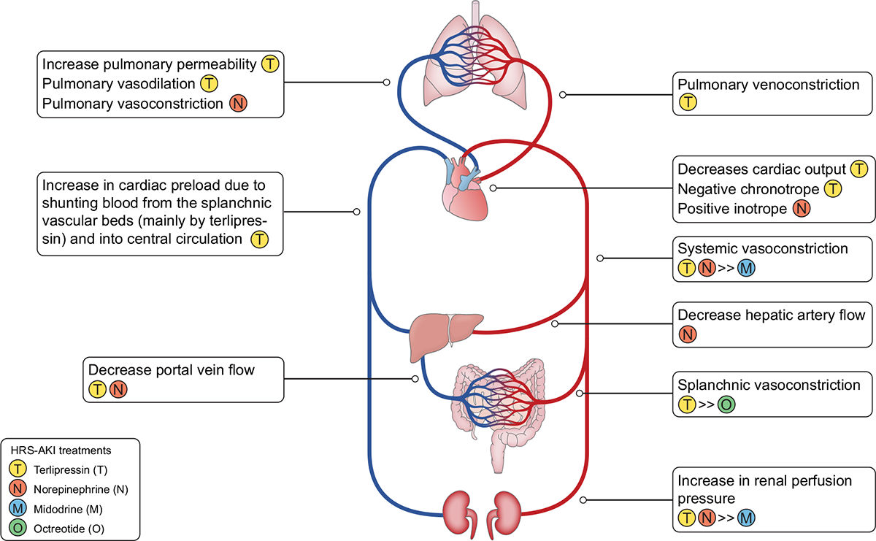
What each HRS drug does to the heart and lungs
Nadim MK et al. J Hepatol 2024;81:163-83 [PMID: 38527522], Fig. 5 (CC BY 2.0, adapted from ADQI)
Notes:
Terlipressin raises kidney perfusion pressure but shunts splanchnic blood centrally, raises afterload and lowers cardiac output, and can constrict the pulmonary vessels. Add large doses of albumin and you get pulmonary edema. Norepinephrine raises cardiac output and causes less splanchnic shunting. Midodrine with octreotide gives only modest splanchnic constriction.

Slide 97
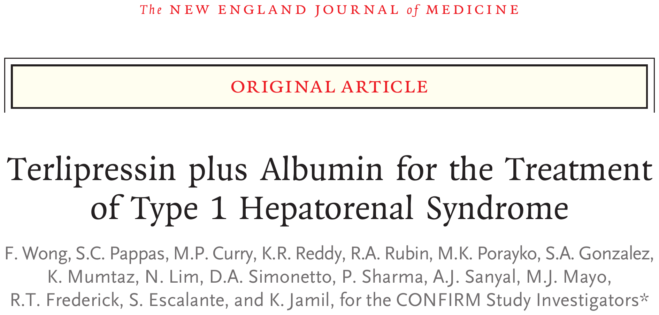
Does HRS reversal mean survival?
What do you think they found?
Wong F et al. N Engl J Med 2021;384:818-28 [PMID: 33657294]

Slide 98
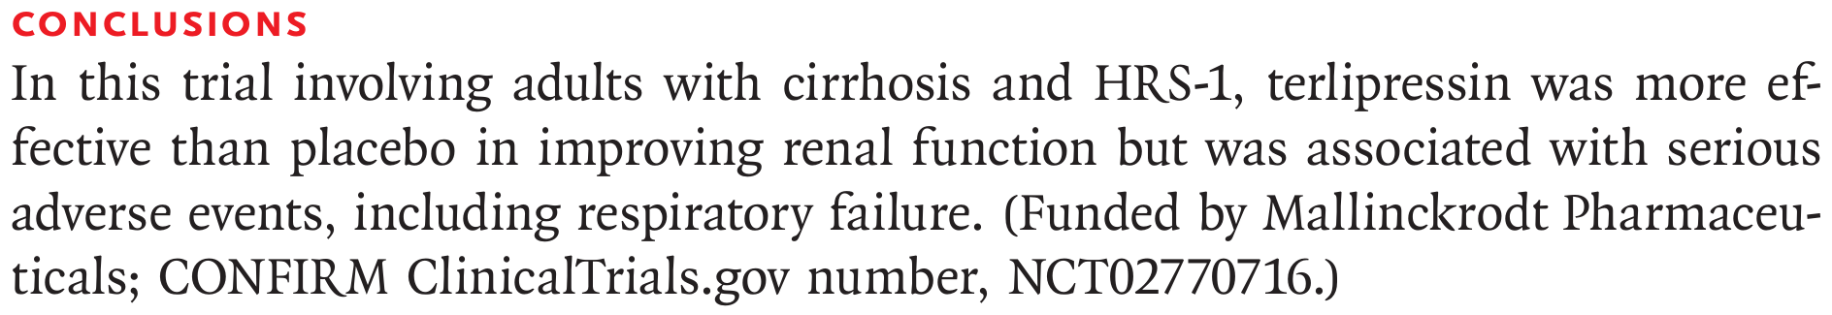
Does HRS reversal mean survival?
Wong F et al. N Engl J Med 2021;384:818-28 [PMID: 33657294]
Notes:
CONFIRM: 300 patients with HRS type 1, terlipressin plus albumin vs placebo plus albumin, randomized 2:1. Their own conclusion already has the catch in it.

Slide 99
Does HRS reversal mean survival?
CONFIRM: type 1 HRS, 300 patients
More kidneys recovered
More patients died of respiratory failure
All-cause 90-day mortality was not different
Respiratory failure as an adverse event: about 14% vs 5% (label)
Wong F et al. NEJM 2021 [PMID: 33657294]; TERLIVAZ prescribing information, revised 6/2026
Notes:
The respiratory harm clustered in patients with volume overload and ACLF grade 3, which is how the label language came about. The label's own reanalysis gives slightly different reversal numbers (29% vs 16%); either way the direction is the same.

Slide 100
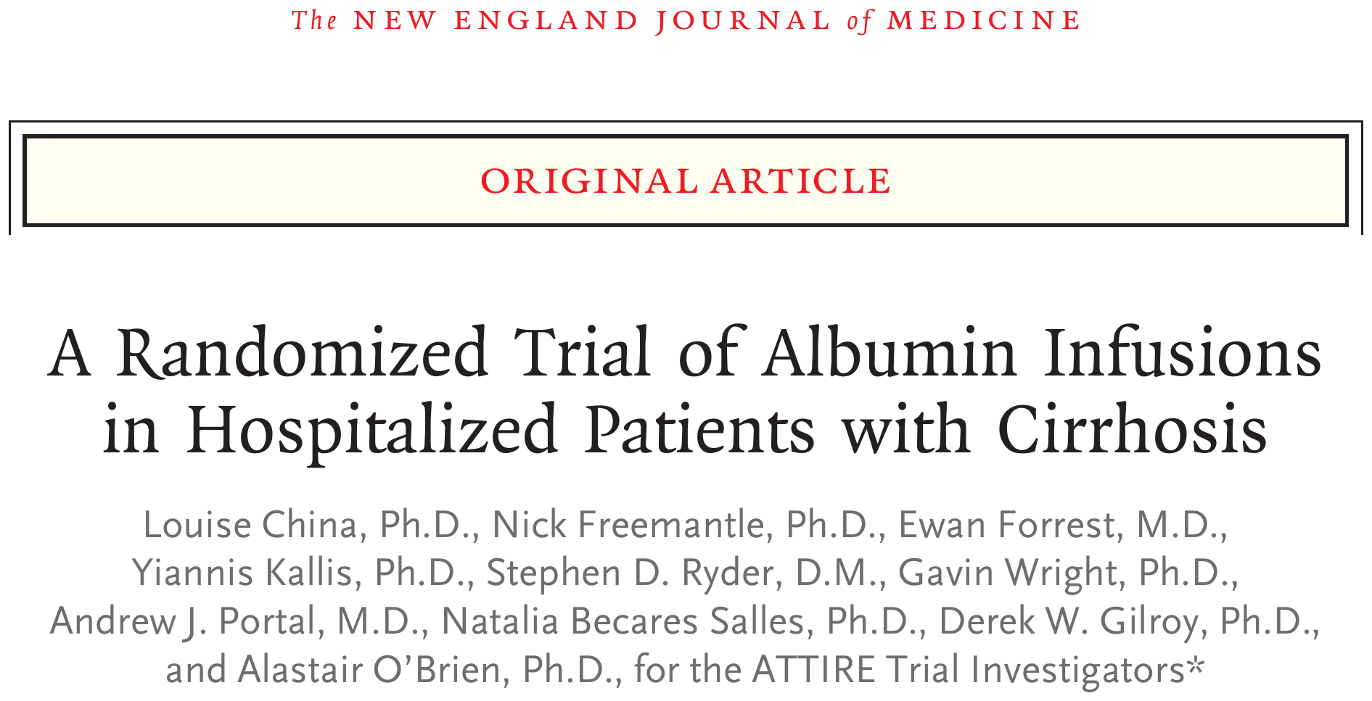
Should we treat the albumin number?
What do you think they found?
China L et al. N Engl J Med 2021;384:808-17 [PMID: 33657293]

Slide 101
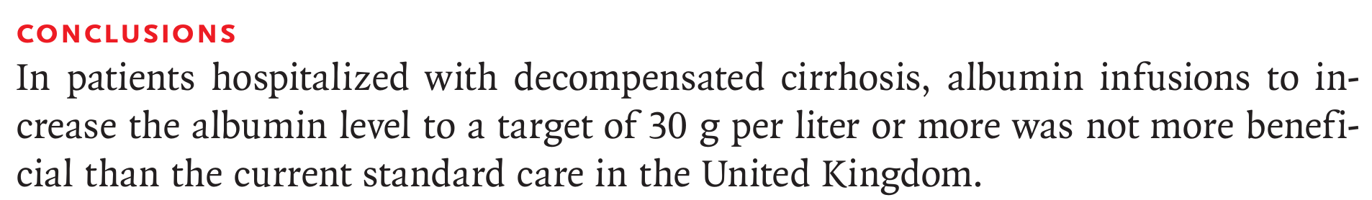
Should we treat the albumin number?
China L et al. N Engl J Med 2021;384:808-17 [PMID: 33657293]
Notes:
ATTIRE: 777 hospitalized patients with decompensated cirrhosis and albumin under 30 g/L, in 35 UK hospitals.

Slide 102
Should we treat the albumin number?
Study | ATTIRE: daily albumin to keep serum albumin ≥ 30 g/L vs standard care, hospitalized decompensated cirrhosis, 777 patients
Main finding | Composite of new infection, kidney dysfunction or death: 29.7% vs 30.2%
The catch | More serious adverse events with albumin, including fluid overload and pulmonary edema
When albumin is indicated
SBP: 1.5 g/kg on day 1, 1 g/kg on day 3
Paracentesis over 5 L: 6 to 8 g per liter removed
HRS-AKI: with a vasoconstrictor, dosed to volume status
China L et al. NEJM 2021 [PMID: 33657293]; ADQI-ICA 2024 [PMID: 38527522]
Notes:
ATTIRE doesn't invalidate albumin for its accepted uses. It does tell you that giving albumin to fix a number causes harm without benefit. Patient B got the right albumin for SBP and still got wet.

Slide 103
Midodrine and octreotide for HRS-AKI?
Head to head: terlipressin vs midodrine plus octreotide, both with albumin, type 1 HRS
How different can two vasoconstrictors be?

Slide 104
Midodrine and octreotide for HRS-AKI?
Randomized, 8 Italian centers, type 1 HRS. 49 randomized (27 vs 22), 48 analyzed
Stopped early at the interim analysis because the difference was already clear
Blood pressure rose more with terlipressin
3-month survival 59% vs 43%; too small to tell
Use it only if terlipressin and norepinephrine are not options
Cavallin M et al. Hepatology 2015;62:567-74 [PMID: 25644760]; ADQI-ICA 2024 [PMID: 38527522]
Notes:
Midodrine and octreotide were the US default for years because terlipressin wasn't available. In the randomized comparison with terlipressin, 1 of 21 analyzed patients had a complete response. It wasn't powered for mortality. Most of them are on the floor at the time, so the practical message for the ICU is simple: once he needs an ICU bed, norepinephrine with albumin is the alternative to terlipressin, not midodrine and octreotide. About half of the midodrine non-responders were rescued with terlipressin, and most of those then responded.

Slide 105
What changed since yesterday?
 | Day 1 | Day 2 | Day 3 | Day 5
Norepinephrine (mcg/kg/min) | 0.15 | 0.22 | 0.12 | Off
Oxygen, SpO2 | Venturi 0.35, 92% | HFNC 0.6, 90% | HFNC 0.4, 95% | 2 L, 97%
Lung failure? | No (P/F 211) | Yes (S/F 150) | No (S/F 238) | No
Kidney | Cr 2.6 | Cr 3.1 | CRRT for fluid | On CRRT
Encephalopathy | Grade II | Grade II | Grade I | Grade I
Bilirubin / INR | 5.8 / 2.1 | 6.4 / 2.3 | 6.1 / 2.2 | 5.2 / 2.0
ACLF grade | 2 | 3 | 2 | ?
Better or worse? What do you tell his family?
Made-up numbers for teaching. CLIF-C ACLF score [PMID: 24950482]; EASL ACLF 2023 [PMID: 37364789]
Notes:
Day 3: CRRT started for fluid overload and oliguria, while the transplant evaluation was under way. Ask the room whether he is better or worse.

Slide 106
What changed since yesterday?
 | Day 1 | Day 2 | Day 3 | Day 5
Norepinephrine (mcg/kg/min) | 0.15 | 0.22 | 0.12 | Off
Oxygen, SpO2 | Venturi 0.35, 92% | HFNC 0.6, 90% | HFNC 0.4, 95% | 2 L, 97%
Lung failure? | No (P/F 211) | Yes (S/F 150) | No (S/F 238) | No
Kidney | Cr 2.6 | Cr 3.1 | CRRT for fluid | On CRRT
Encephalopathy | Grade II | Grade II | Grade I | Grade I
Bilirubin / INR | 5.8 / 2.1 | 6.4 / 2.3 | 6.1 / 2.2 | 5.2 / 2.0
ACLF grade | 2 | 3 | 2 | 1
The grade at days 3 to 7 predicts outcome better than the grade at admission
Persistent ACLF 3 at days 3 to 7, especially with four or more organ failures, has a very high mortality without transplant
If he is not a transplant candidate, discuss goals of care with the family and involve palliative care
Made-up numbers for teaching. CLIF-C ACLF score [PMID: 24950482]; EASL ACLF 2023 [PMID: 37364789]
Notes:
Grading is a snapshot; the trend is what you act on. Kidney failure on RRT still counts as an organ failure. Bring palliative care in alongside, not instead of, full support. Document what the time-limited trial is and when you'll reassess.

Slide 107
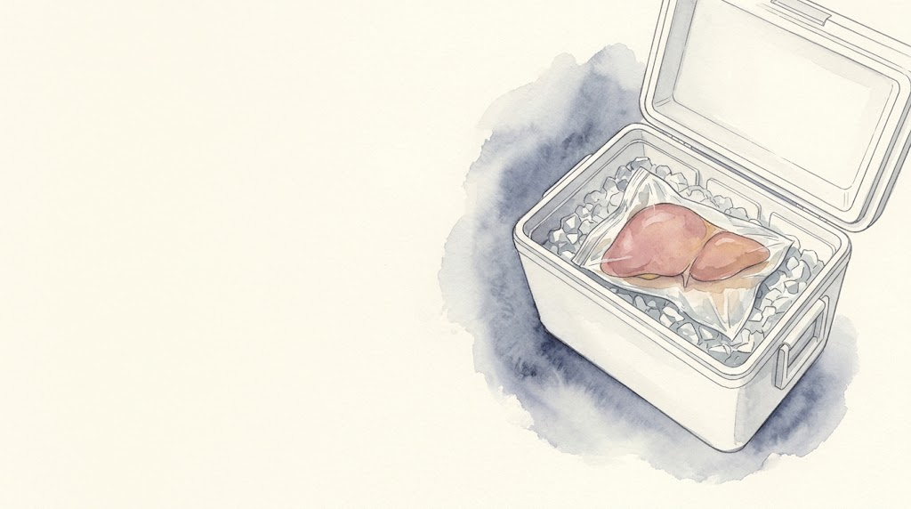
Who gets a liver?
Transplant in ACLF
Notes:
Back to the question both families will ask.

Slide 108
Too sick for a transplant, or sick enough to need one?
Ventilator, pressors, CRRT, ACLF 3. Is he too sick?

Slide 109
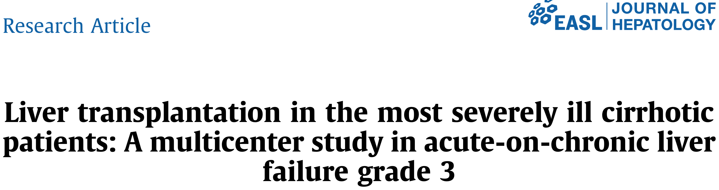
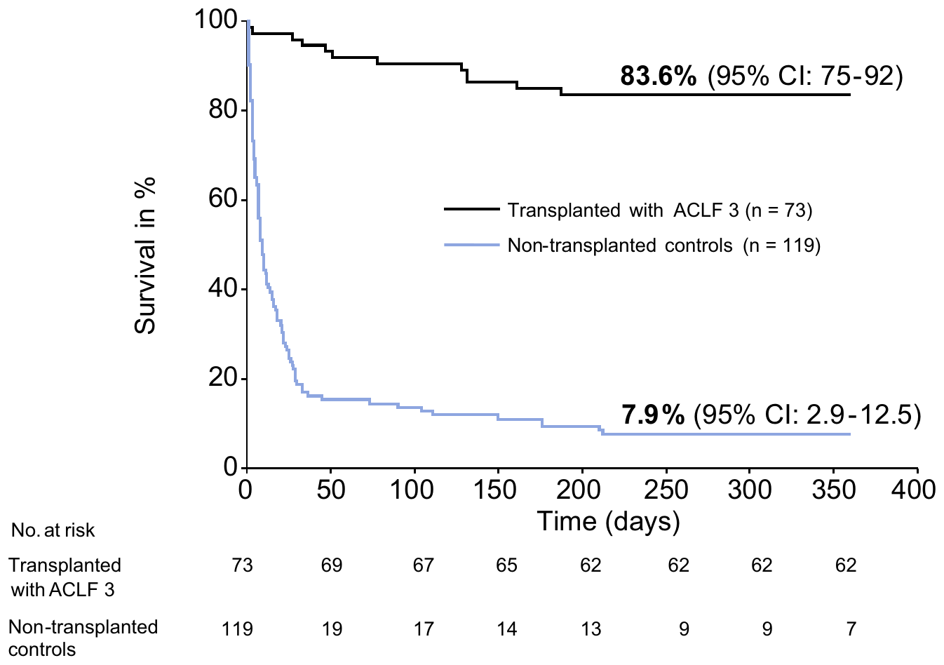
Too sick for a transplant, or sick enough to need one?
A ventilator, pressors or dialysis do not by themselves exclude transplant
Selected patients with ACLF grade 3 do well after transplant. The window is short
What can close the window
Uncontrolled infection
Rising vasopressor needs, severe respiratory failure
Irreversible brain injury
Frailty and comorbidity
Alcohol: centers now evaluate individually rather than by a fixed abstinence rule
Selected patients, not randomized
Artru F et al. J Hepatol 2017 [PMID: 28645736]; Lancet Gastroenterol Hepatol 2024 [PMID: 38309288]; AASLD/AST 2026 [PMID: 41405234]
Notes:
Referral, candidacy, listing and allocation are four different decisions. The ICU team owns the referral and the information. Status 1A and other allocation rules: check current OPTN policy before quoting them. Artru's comparison is not randomized: the transplanted patients were selected, so the gap overstates what transplant adds for an unselected ACLF 3 patient. It still shows that ACLF 3 alone is not a reason to say no. The curve shows 83.6% for all 73 transplanted patients; the abstract's 83.9% vs 7.9% is the matched comparison.

Slide 110
Calling transplant hepatology
Call first. Gather this while you wait for the call back
Patient A (ALF) | Patient B (ACLF)
Cause and time course (days from jaundice to encephalopathy) Encephalopathy grade, pupils, sedation Airway and ventilator settings Ammonia, sodium, CRRT INR, lactate, pH, glucose trends Pressors, infection Social support, intent of ingestion | Cause of cirrhosis, recent alcohol use Precipitant and source control Organ failures today and yesterday Pressor dose, oxygen, RRT MELD, CLIF-C scores Frailty, comorbidities Prior transplant evaluation, support
Notes:
Nothing on this list should delay the first call. A good call makes the transplant team's decision faster. Trends, not single values. Referral, candidacy, listing and allocation are separate decisions; the first one is ours.

Slide 111
ALF and ACLF: what changes at the bedside
Both have a sick liver. Do they have the same disease?
 | Acute liver failure | ACLF
Ammonia
Lactulose
Sodium
Antibiotics
INR
ACG ALF 2023 [PMID: 37377263]; SCCM 2023 [PMID: 37052436]; update 2022 [PMID: 36001996]
Notes:
Probably the most useful slide to photograph. The sodium row is where people get hurt: an induced-hypernatremia target transferred into a chronically hyponatremic cirrhotic causes osmotic demyelination.

Slide 112
ALF and ACLF: what changes at the bedside
Both have a sick liver. Do they have the same disease?
 | Acute liver failure | ACLF
Ammonia | With the HE grade and the trend: brain risk, and when to start CRRT. No level rules out ICH | Doesn't diagnose HE. Don't trend it to dose lactulose
Lactulose | No proven benefit; bowel distension can get in the way of surgery | Yes for overt HE, plus treat the trigger. Rifaximin as an add-on. Avoid dehydration
Sodium | Grade III-IV or high ammonia: center protocol, often 145 to 155, matched to the CRRT fluid | Often chronically low: correct slowly. In high-risk patients, no more than 8 mmol/L in 24 hours
Antibiotics | No routine prophylaxis. Surveillance cultures, low threshold to treat | Treat infection fast; prophylaxis with GI bleeding
INR | Tracks severity, poor at predicting bleeding. No plasma just for the number | Same. Judge the procedure and the patient
ACG ALF 2023 [PMID: 37377263]; SCCM 2023 [PMID: 37052436]; update 2022 [PMID: 36001996]
Notes:
Probably the most useful slide to photograph. The sodium row is where people get hurt: an induced-hypernatremia target transferred into a chronically hyponatremic cirrhotic causes osmotic demyelination.

Slide 113
What happened to them
Bed 4
Day 0
Admitted, NAC
Day 1
Intubated, CRRT
Day 2
Listed 1A
Day 4
Transplanted
Day 19
Home
Bed 7
Day 1
SBP, ACLF 2
Day 2
ACLF 3
Day 5
Off pressors, ACLF 1
Day 12
Off CRRT
Day 21
Home, transplant clinic
Made-up outcomes for teaching
Notes:
Both made it, which is not the usual story. Bed 7 could just as easily have stayed ACLF 3 on day 5, and then the conversation is the one on the transplant slide.

Slide 114
Back to our patients
Which one needed transplant hepatology before the tests came back?
Why did a falling ALT make you more worried?
When is CRRT right before the creatinine is high?
Why isn't lactulose for ACLF evidence for ALF?
Why were albumin and terlipressin the wrong next step for bed 7?
What would make you change yesterday's plan?
Notes:
Ask the room. Don't put the answers up.

Slide 115
Some tricks of the trade
High AST and ALT alone are not liver failure. Get an INR and examine the patient
Stabilize, treat the cause and call transplant hepatology in the same hour
ALF: protect the brain. Intubate at grade III, keep the CO2 normal, follow your center's sodium plan, and start CRRT for rising ammonia
ACLF: count the organs, find the trigger
ACLF: check oxygenation and volume status before albumin or terlipressin
Reassess organ failures daily. The trend matters more than the admission score

Slide 116
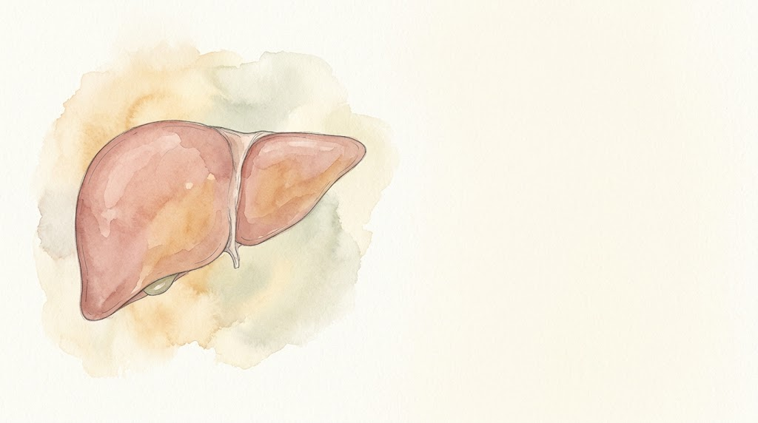
Questions?

Slide 117
Appendix: West Haven grades
Grade | What you see
I | Short attention, mild confusion, reversed sleep, subtle personality change
II | Lethargy, disorientation to time, obvious personality change, asterixis
III | Somnolent but rousable to voice or pain, grossly disoriented, bizarre behavior
IV | Coma
Notes:
In ALF, grade III-IV is the intubation and ICP-risk threshold.

Slide 118
Appendix: King's College criteria
Acetaminophen | Not acetaminophen
Arterial pH < 7.30 after fluids or all three within 24 hours: INR > 6.5 Creatinine > 3.4 mg/dL Grade III-IV encephalopathy (Modified: lactate > 3.5 at 4 h or > 3.0 at 12 h after fluids) | INR > 6.5 or any three of: Age < 10 or > 40 Drug reaction, or indeterminate cause Jaundice to encephalopathy > 7 days INR > 3.5 Bilirubin > 17.5 mg/dL
Original O'Grady criteria; the lactate line is the later modification
O'Grady 1989 criteria, as summarized in EASL 2017 [PMID: 28417882] and update 2022 [PMID: 36001996]
Notes:
Specific but not sensitive. Use them to understand prognosis, not to decide when to call.

Slide 119
Appendix: arterial ammonia studies in ALF
Study (arterial ammonia) | Patients | What they found | The catch
Clemmesen 1999, Copenhagen | 44 ALF | 14 herniated. Mean ammonia 230 vs 118 μmol/L; every herniation was above 146 | Small, one center
Bhatia 2006, Delhi | 80 ALF | Admission ammonia ≥ 124 predicted death (sensitivity 79%, specificity 76%) | One center; the endpoint was death, not ICH
Bernal 2007, King's | 165 ALF, grade III-IV | > 100 predicted severe HE (70% accuracy). > 200: ICH in 55% | 200 missed most of the ICH cases
Kumar 2012, Delhi | 295 ALF | ≥ 122 for 3 days: survival 23% vs 72%, cerebral edema 71% vs 37% | One center, but the trend beat a single value
Above 150 to 200 and not falling: worry about the brain
ICH can occur below 200. Interpret the level with the HE grade and the trend
Clemmesen 1999 [PMID: 10051463]; Bhatia 2006 [PMID: 16024550]; Bernal 2007 [PMID: 17685471]; Kumar 2012 [PMID: 22521861]
Notes:
All four used arterial ammonia, measured in micromoles per liter. The pattern is consistent: higher and more persistent ammonia, more cerebral edema and death. But no single cutoff works on its own. In Bernal's King's cohort, more than 200 meant intracranial hypertension in 55%, yet most patients who developed ICH were below 200. So use it as a risk marker together with the grade of encephalopathy, the time course and the trend. Patient A went 182 then 214. That's the trajectory you act on with CRRT. Practical point: whatever you send, arterial or venous, put it on ice and get it run quickly. A delayed sample reads falsely high. In cirrhosis, by contrast, a single ammonia doesn't diagnose HE and shouldn't be trended to dose lactulose.

Slide 120
Appendix: which ACLF?
 | EASL-CLIF | NACSELD | APASL
Who | Cirrhosis with acute decompensation | Cirrhosis, hospitalized | Chronic liver disease, with or without cirrhosis
Defined by | Organ failures (CLIF-C) | Two or more extrahepatic failures: shock, grade III-IV HE, dialysis, ventilation | Jaundice (bilirubin ≥ 5) and INR ≥ 1.5, then ascites or HE within 4 weeks
Picks up | Broader, earlier | Sicker patients | A primary liver insult
They find different patients. Say which one you're using
Kyoto consensus 2025 [PMID: 39961976]; ACG ACLF 2022 [PMID: 35006099]; AASLD 2024 [PMID: 37939273]
Notes:
Not worth memorizing all three. Worth knowing that a paper's 'ACLF' may not be your patient's ACLF. The talk uses EASL-CLIF.

Slide 121
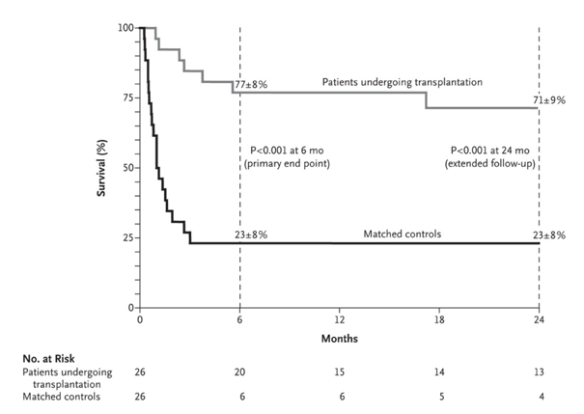
Appendix: early transplant for alcohol-associated hepatitis
26 patients with a first episode of severe alcohol-associated hepatitis, not responding to steroids
Highly selected: first liver-related event, close family support, no severe other illness, agreed to abstinence
6-month survival 77% vs 23%
Recent drinking alone is not a reason to skip the call
Mathurin P et al. N Engl J Med 2011 [PMID: 22070476]
Notes:
This is the study that broke the six-month rule. The selection was strict, and later US data (ACCELERATE-AH) showed similar results in selected patients. Patient B's trigger was SBP, not alcohol-associated hepatitis; this is here for the alcohol question that comes up with every cirrhotic in the ICU. The alcohol history is a question for the transplant team, not a decision the ICU makes alone.

Slide 122
Appendix: sources (1)
SCCM ALF/ACLF ICU guidelines, part 1. Crit Care Med 2020 [PMID: 32058387]
SCCM ALF/ACLF ICU guidelines, part 2. Crit Care Med 2023 [PMID: 37052436]
EASL acute liver failure guideline. J Hepatol 2017 [PMID: 28417882]
ACG acute liver failure guideline. Am J Gastroenterol 2023 [PMID: 37377263]
Management of acute liver failure: update 2022. Semin Liver Dis [PMID: 36001996]
Acute liver failure: a practical update. JHEP Rep 2024 [PMID: 39170946]
EASL ACLF guideline. J Hepatol 2023 [PMID: 37364789]
AASLD ACLF and critically ill cirrhosis guidance. Hepatology 2024 [PMID: 37939273], errata [PMID: 38551831], [PMID: 42467893]
ACG ACLF guideline. Am J Gastroenterol 2022 [PMID: 35006099]
ADQI-ICA consensus on AKI in cirrhosis. J Hepatol 2024 [PMID: 38527522]
Surviving Sepsis Campaign 2026. Crit Care Med [PMID: 41869847]
EASL autoimmune hepatitis guideline. J Hepatol 2025 [PMID: 40348684]
EASL hepatic encephalopathy guideline. J Hepatol 2022 [PMID: 35724930]
US/Canada acetaminophen poisoning consensus. JAMA Netw Open 2023 [PMID: 37552484]

Slide 123
Appendix: sources (2)
Moreau R et al. CANONIC. Gastroenterology 2013 [PMID: 23474284]
Jalan R et al. CLIF-C ACLF score. J Hepatol 2014 [PMID: 24950482]
Lee WM et al. NAC in non-acetaminophen ALF. Gastroenterology 2009 [PMID: 19524577]
Clemmesen JO et al. Cerebral herniation and arterial ammonia. Hepatology 1999 [PMID: 10051463]
Bernal W et al. Arterial ammonia, HE and intracranial hypertension. Hepatology 2007 [PMID: 17685471]
Bhatia V et al. Arterial ammonia in ALF. Gut 2006 [PMID: 16024550]
Kumar R et al. Persistent hyperammonemia in ALF. Clin Gastroenterol Hepatol 2012 [PMID: 22521861]
Cardoso FS et al. CRRT and ammonia in ALF. Hepatology 2018 [PMID: 28859230]
Pre-emptive CRRT in ALF with cerebral edema. Aliment Pharmacol Ther 2026 [PMID: 42332991]
Larsen FS et al. High-volume plasma exchange. J Hepatol 2016 [PMID: 26325537]
Cavallin M et al. Terlipressin vs midodrine and octreotide. Hepatology 2015 [PMID: 25644760]
Wong F et al. CONFIRM. NEJM 2021 [PMID: 33657294]
Artru F et al. Transplant in ACLF grade 3. J Hepatol 2017 [PMID: 28645736]
Mathurin P et al. Early transplant for alcoholic hepatitis. NEJM 2011 [PMID: 22070476]
China L et al. ATTIRE. NEJM 2021 [PMID: 33657293]
Liver transplantation for ACLF. Lancet Gastroenterol Hepatol 2024 [PMID: 38309288]
AASLD/AST candidate evaluation guideline. Hepatology 2026 [PMID: 41405234]
Kyoto consensus on ACLF. Hepatol Int 2025 [PMID: 39961976]
TERLIVAZ (terlipressin) prescribing information, revised 6/2026

